Slide 1
Lecture II: The First Galaxies and Reionization

Slide 2
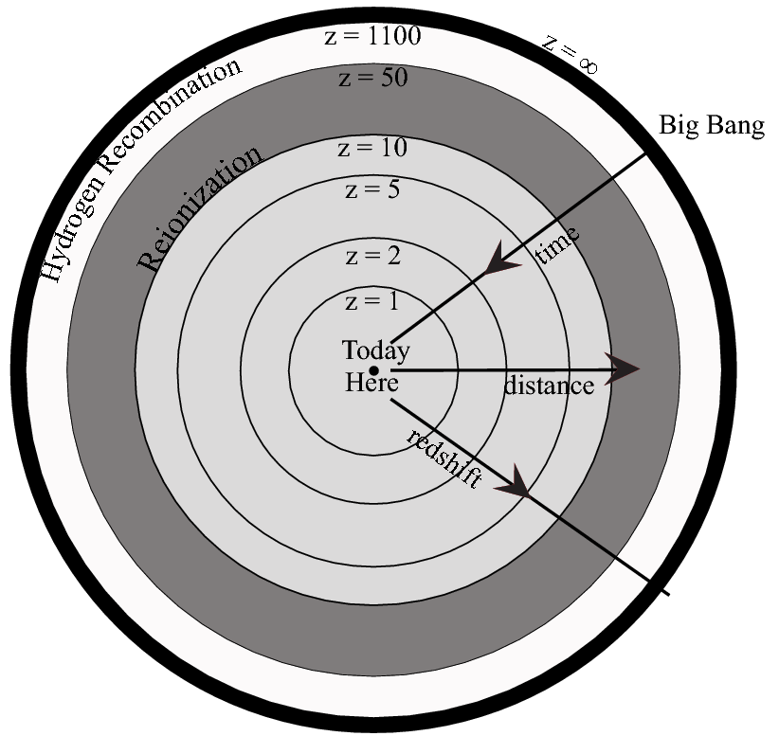
The Visible Universe

Slide 3
The Visible Universe
z>5: most comoving volume (best statistical constraints on high k modes)

Slide 4
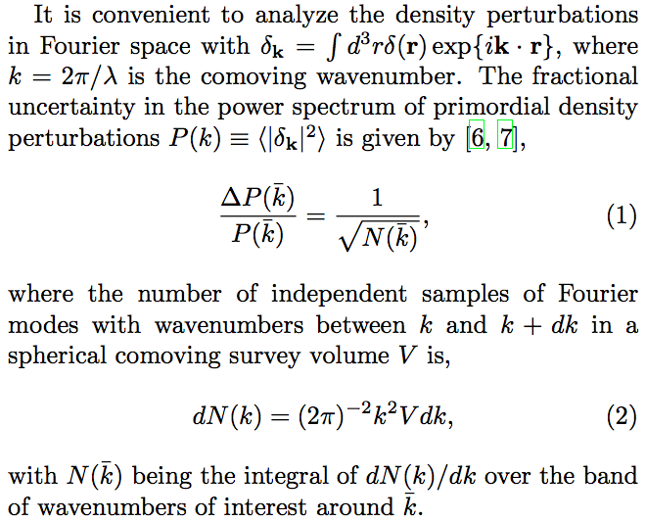

Slide 5
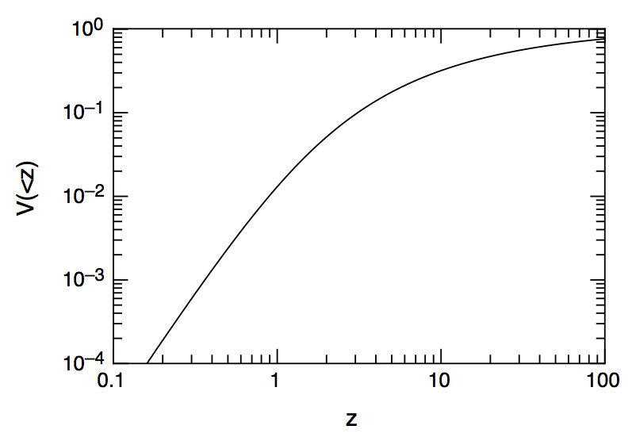




Cumulative Fraction of Comoving Volume
Loeb & Wyithe PRL (2008)

Slide 6
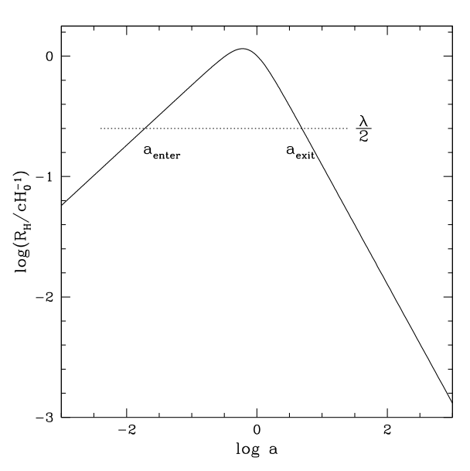
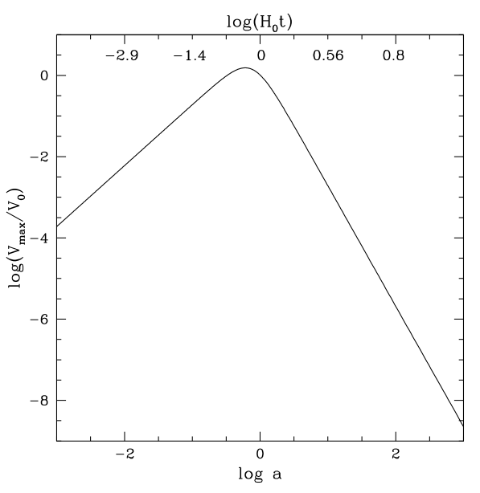
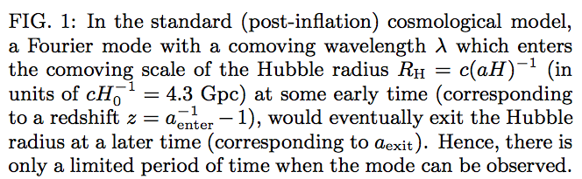
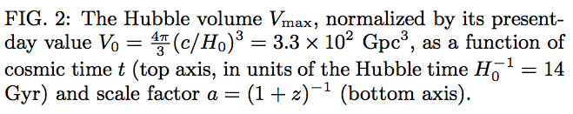
The Optimal Cosmic Time for Constraining the Initial Density Perturbations

Slide 7
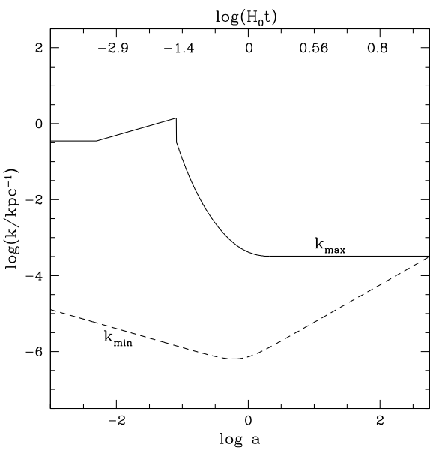
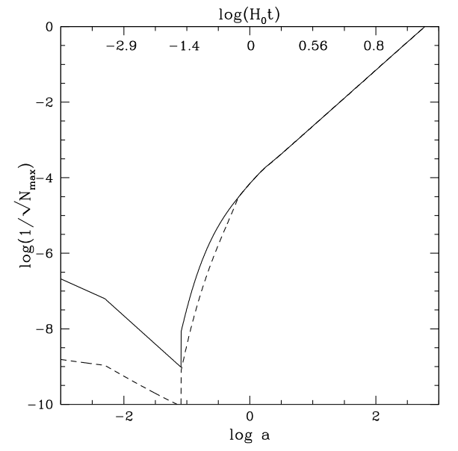
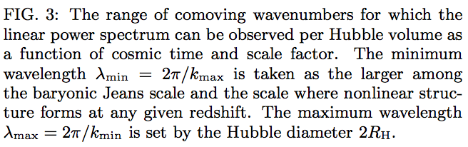
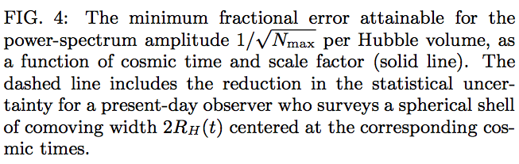
The Optimal Cosmic Epoch for Precision Cosmology
The best constraints on the cosmological initial conditions can be obtained during the epoch of reionization, at z~10

Slide 8
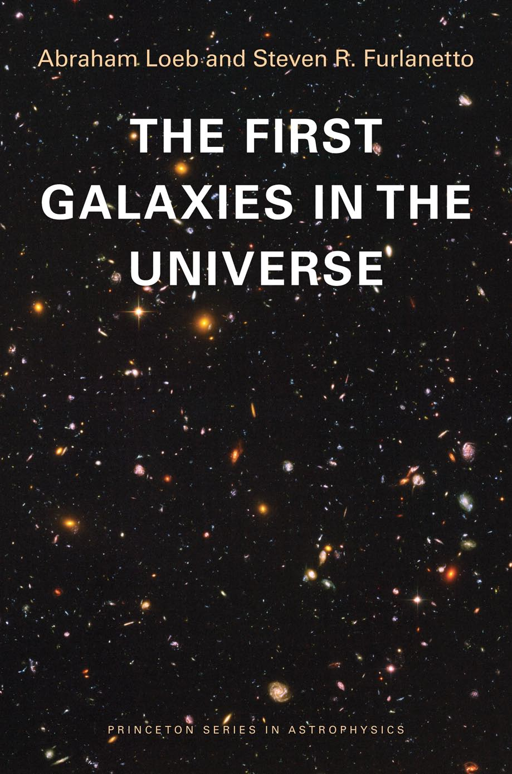

Slide 10
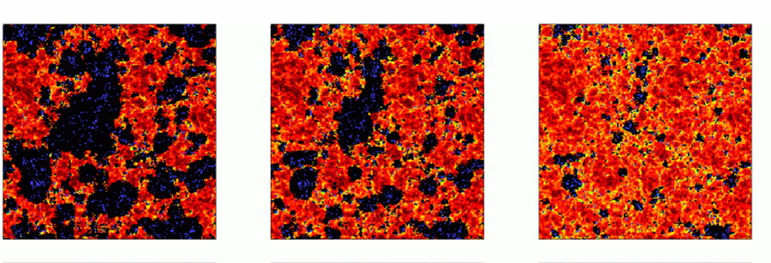
How Did the First Stars and Black Holes Form?
* Standard model of physics and cosmology
* Initial conditions from inflation
* Weakly-interacting Cold Dark Matter
Surprises may signal new physics

Slide 11

Example of New Physics (“venture capital”)
allowed
Strong scattering of dark matter particles (~Thomson cross-section/proton mass) mediated by a massive gauge-boson
Excited states: exothermic
Cores in dwarf galaxies; evaporation of low-mass halos (missing satellite problem, old globular clusters).
Loeb & Weiner, Phys. Rev. Lett. (2011)

Slide 12
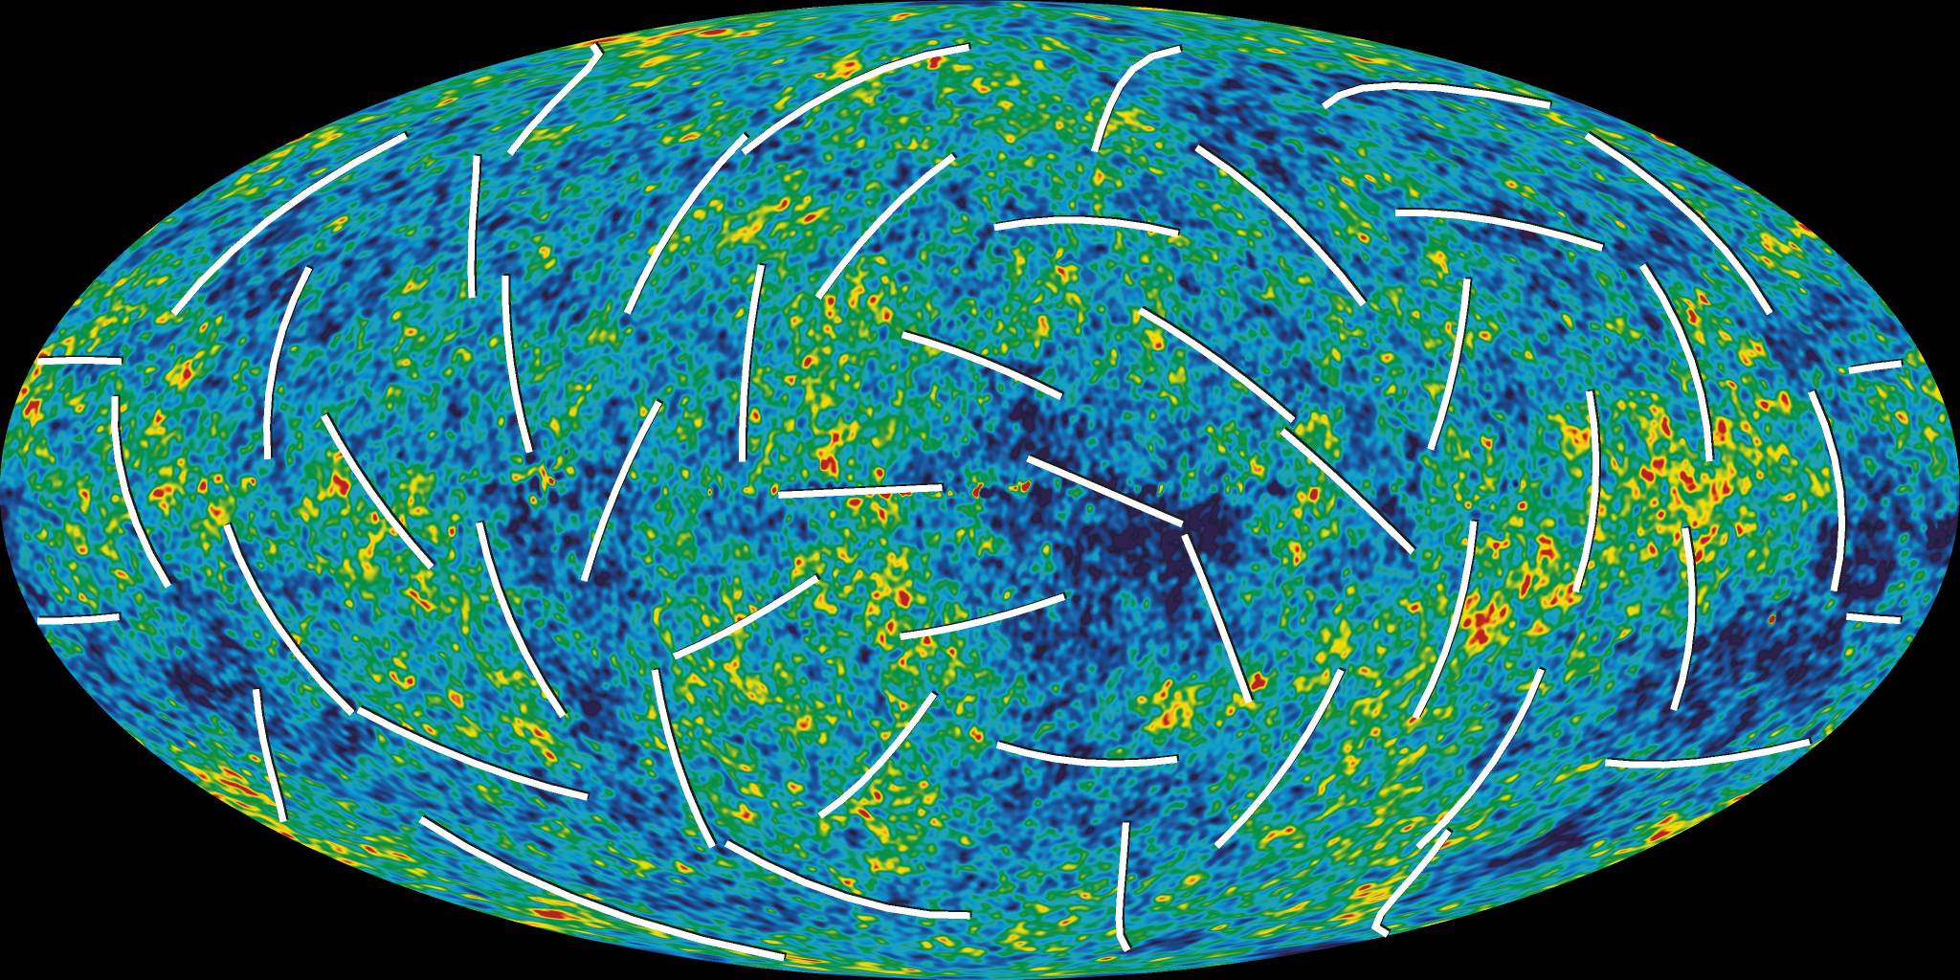

Cosmic Microwave Background (WMAP7)
The polarization data indicates that the first stars must have formed <500 million years after the big bang, when the universe was only a few percent of its current age!

Slide 13
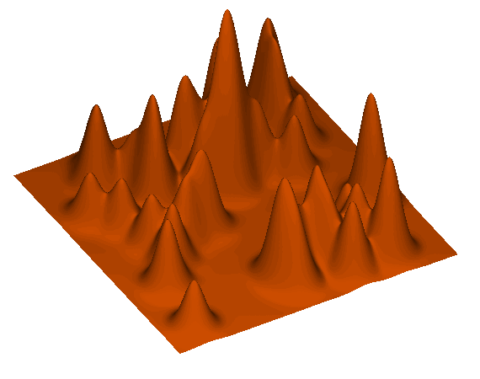

Baryon Streaming Relative to Dark Matter
Streaming of baryons relative to dark matter potential wells acts as an effective inhomogeneous sound speed
Coherence scale of ~3 cMpc >> Jeans scale at z~50
Tseliakhovich & Hirata (2010)

Slide 14
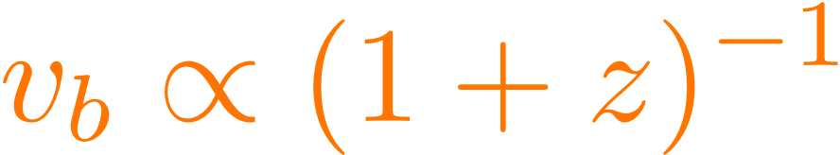


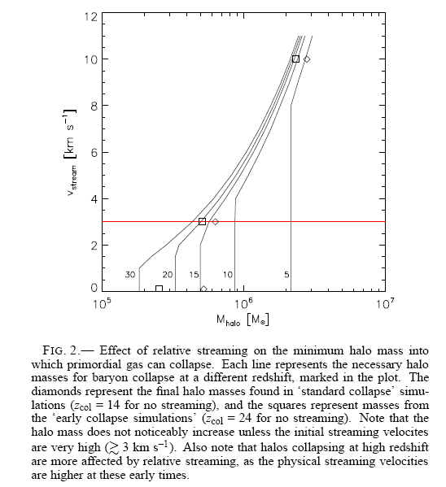
is significant only for halos with well below the HI cooling threshold of
Stacy, Bromm, & Loeb (2011)
Tseliakhovich, Barkana, & Hirata (2011)

Slide 15
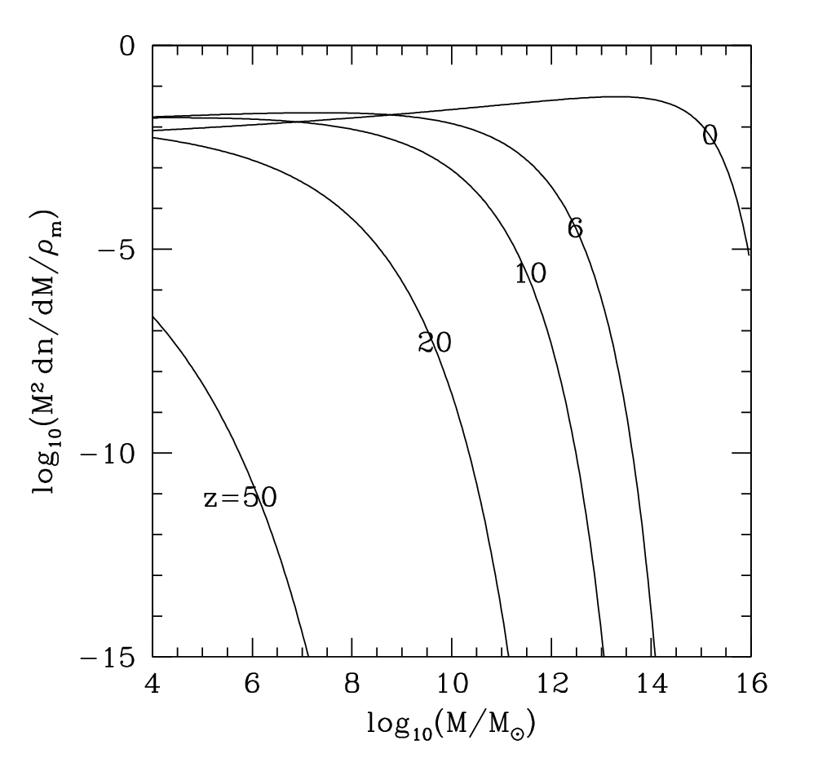

Slide 16
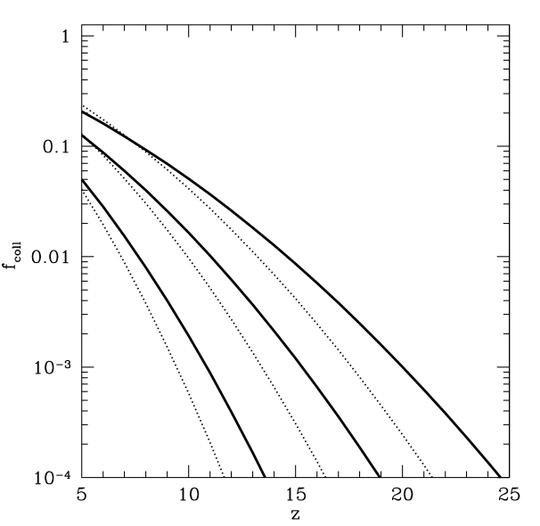




Fraction of collapsed matter
Reionization requires 13.6 eV/H compared to 7 MeV/nucleon produced in stellar interiors

Slide 17
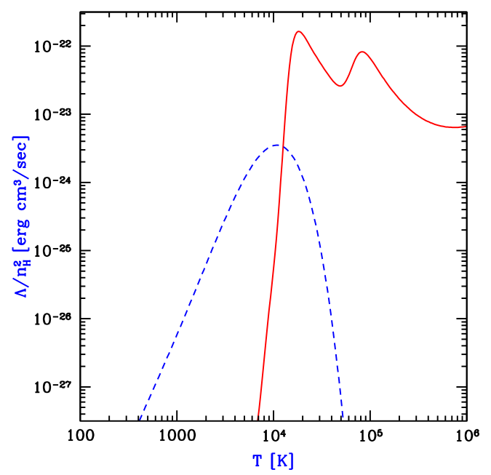
Cooling Rate of Primordial Gas (H,He)

Slide 18
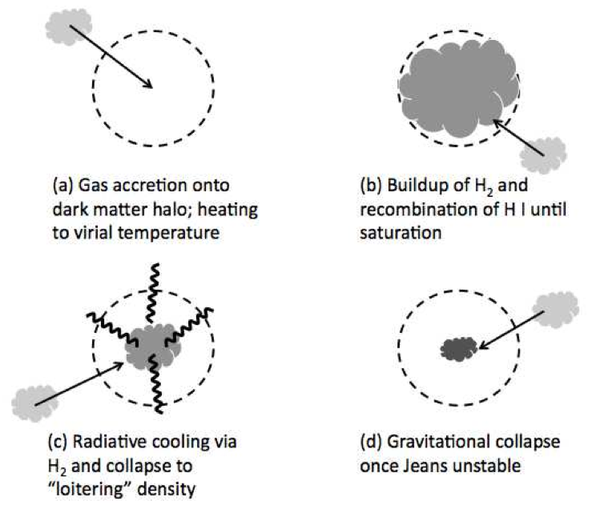
Population III.1

Slide 19
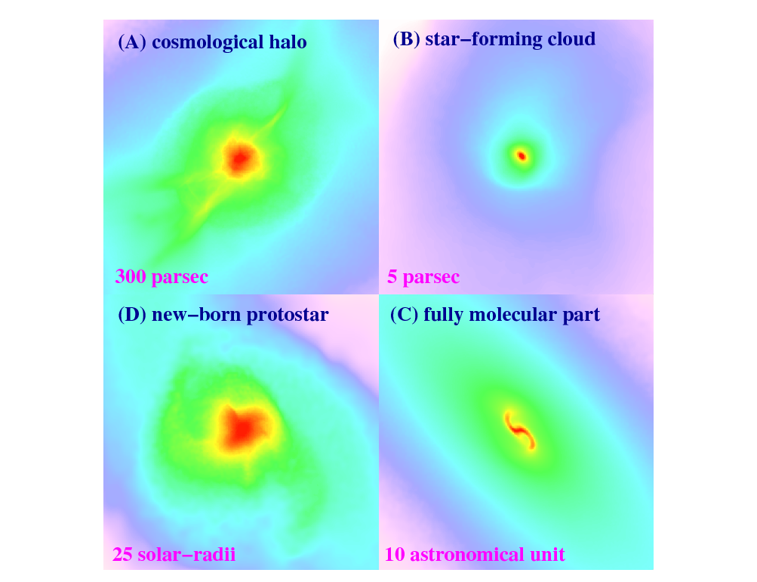



The First Stars Are Predicted to Have Formed ~100 Million Years After the Big Bang
1000 light-years
15 light-years
Bromm et al. (2009)

Slide 20
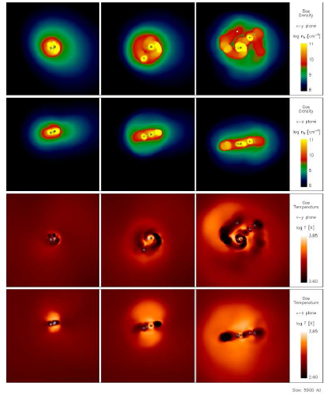
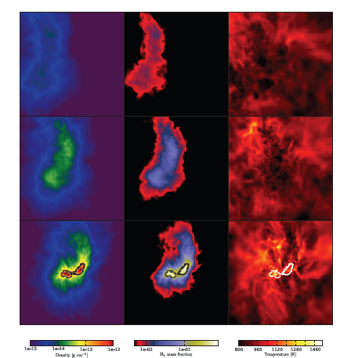
Population III Binaries or Multiples
Turk, Abel, & O’Shea 2009
Stacy, Greif, & Bromm 2009

Slide 21
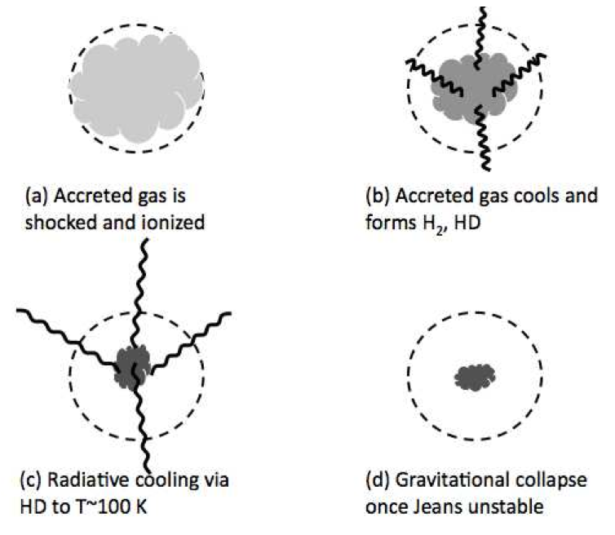
Population III.2

Slide 22
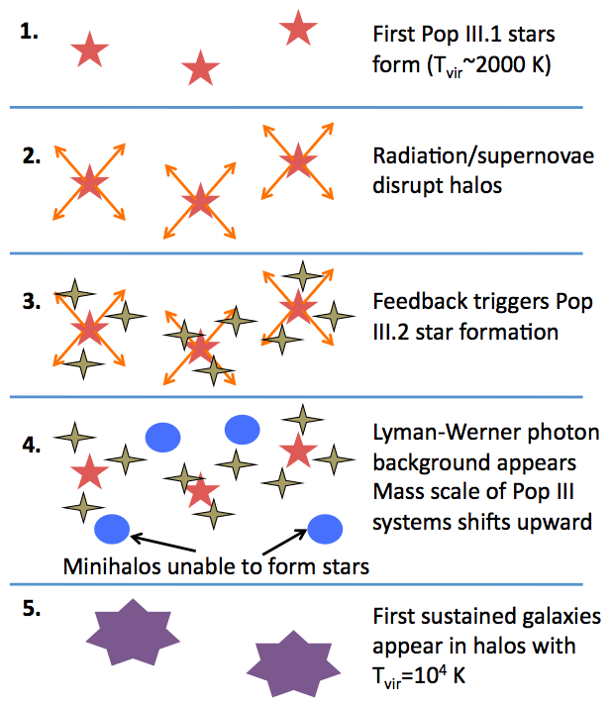

Slide 23
Observing the Stars

Slide 24
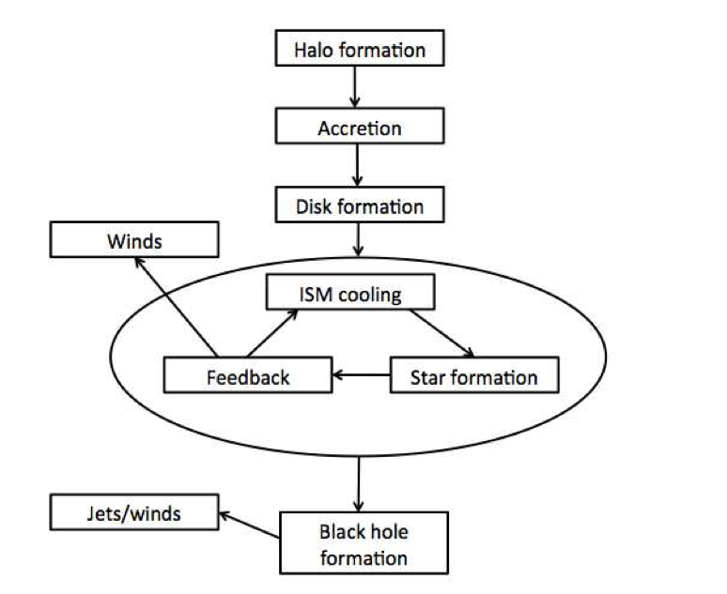
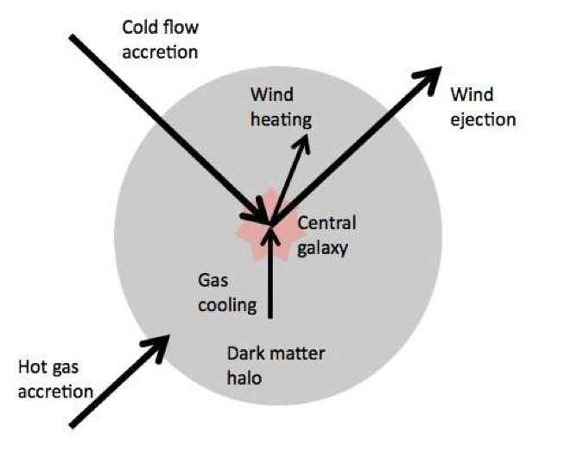

Slide 25
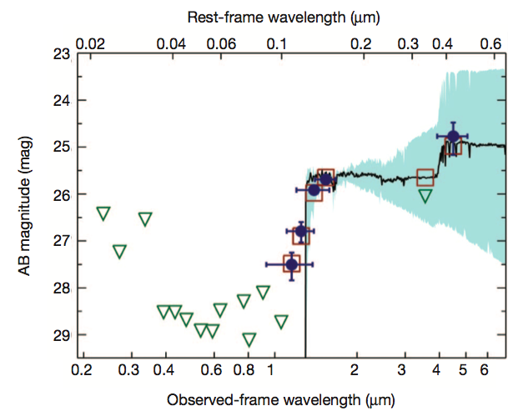
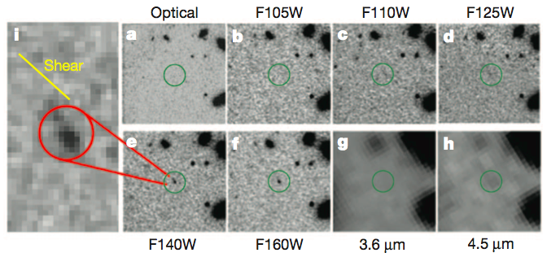
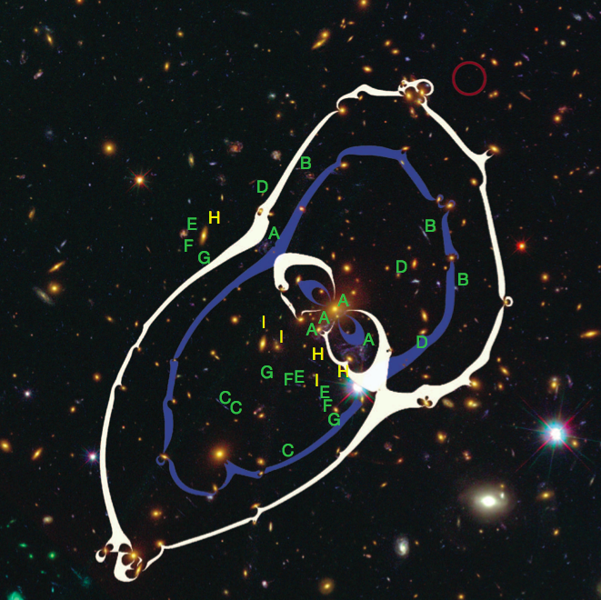


A Magnified Young Galaxy at z~9.6
Zheng et al. (2012)

Slide 26
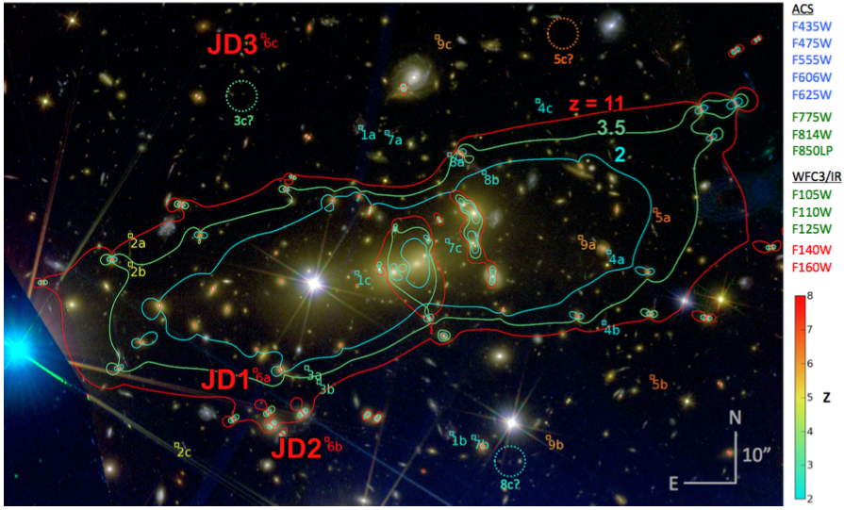
Galaxy at z~11
Coe et al. (2012)

Slide 27
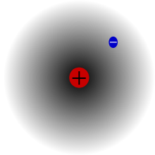
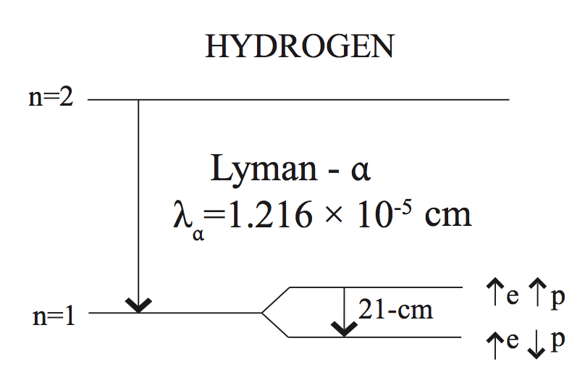
Hydrogen
Most abundant element produced in the Big Bang

Slide 28
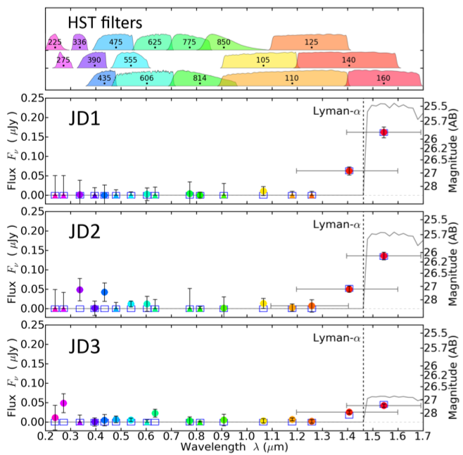
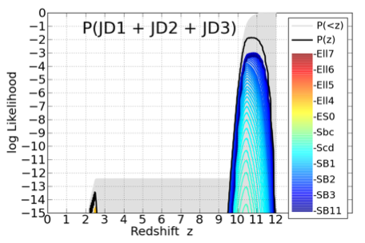
Galaxy at z~11
Coe et al. (2012)

Slide 29
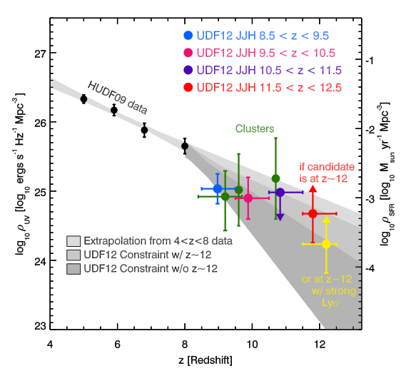
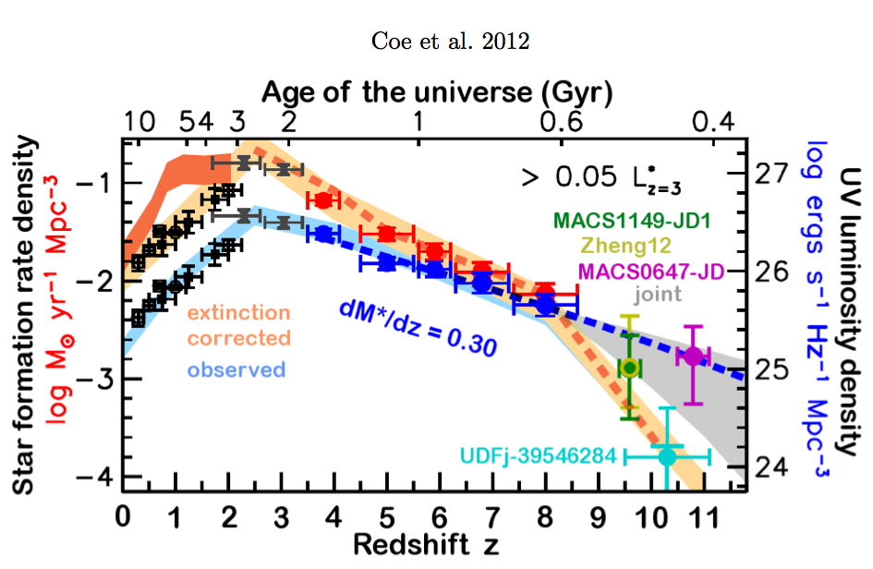
Ellis et al. 2012 (UDF12)

Slide 30
First Galaxies Were Strongly Clustered on Scales of up to ~100 comoving Mpc
z=20
Collapse threshold

Slide 31
First Galaxies Were Strongly Clustered on Scales of up to ~100 comoving Mpc
z=10
Collapse threshold
100 comoving Mpc
Challenges for numerical simulations of reionization:
*Resolving dwarf galaxies as sources of ionizing photons
*Simulation box >100 comoving Mpc on a side
*Following gravity, hydrodynamics, radiative transfer and feedback (dissociation of molecular hydrogen, photo-ionization, heating, metal enrichment)

Slide 32


Requirements for Reionization by Pop II Stars:
To produce one ionizing photon per baryon:
To keep the IGM ionized by compensating for recombinations:

Slide 33
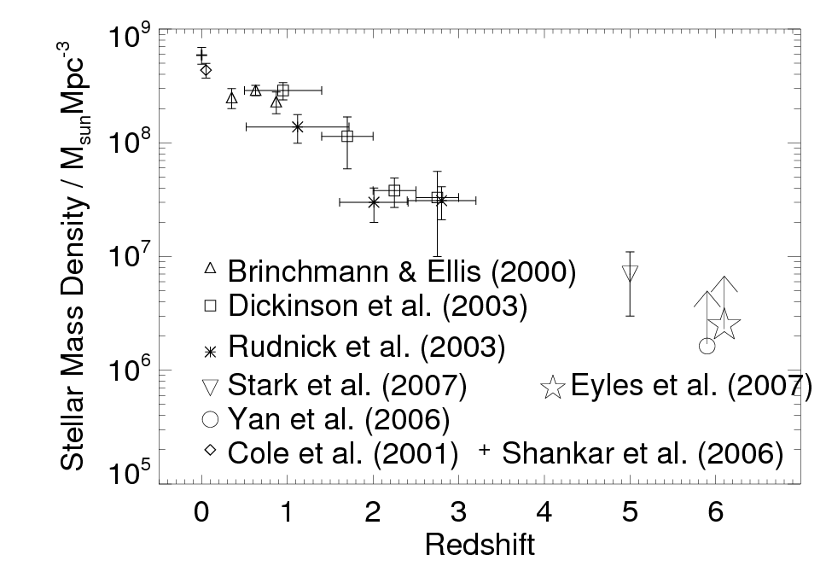
Observed Growth of Mass in Stars
← Time
13.7 billion years
~1% after 1 billion years
one ionizing photon per atom

Slide 34
Redshift Record of Observed Galaxies (one z~10 candidate, Bouwens et al., Nature 2011)
HST WFC3/IR: ~140 galaxies at z~7-8
f_esc/C ionizing photons per baryon
VLT z-dropout Vanzella et al arXiv:1011.5500
Prediction from Barkana & Loeb (2000):
Most SFR at z>10 is in galaxies fainter than 1nJy! (AB>32.9 at 0.6-3.5 micron, ~10 x fainter than WFC3/IR sensitivity)

Slide 35
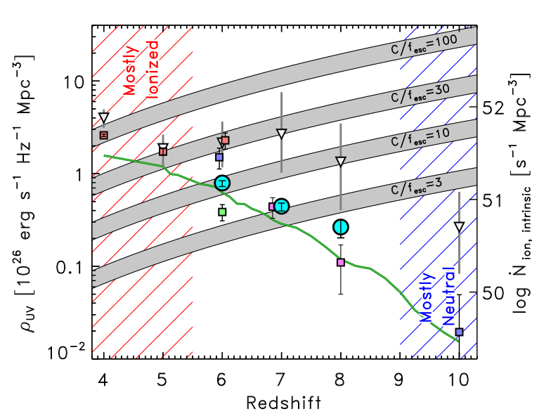
Finkelstein et al. (2012)

Slide 36
James Webb Space Telescope: Searching for the First Light
Mirror diameter: 6.5 meter
Material: beryllium
18 segments
Wavelength coverage: 0.6-28 micron
L2 orbit
Launch date: 2018?

Slide 37
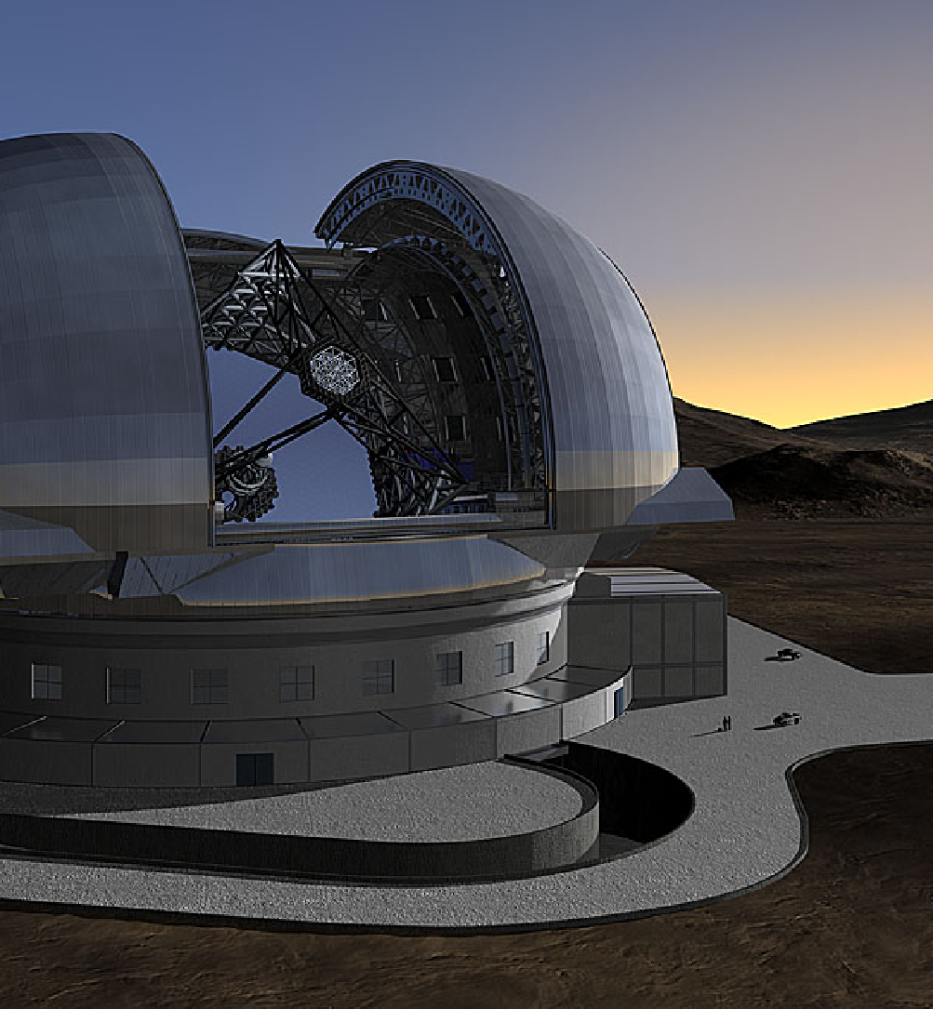
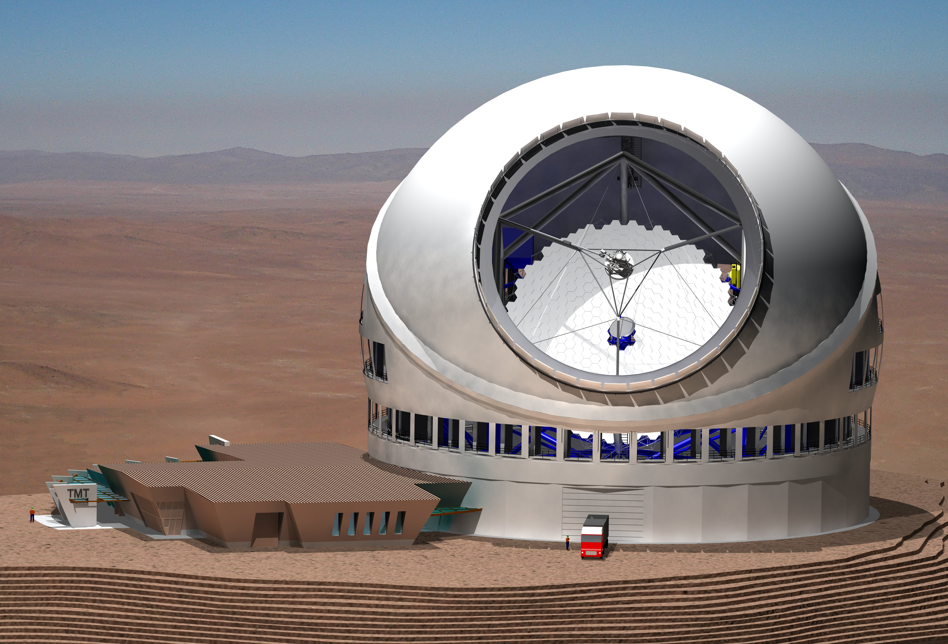
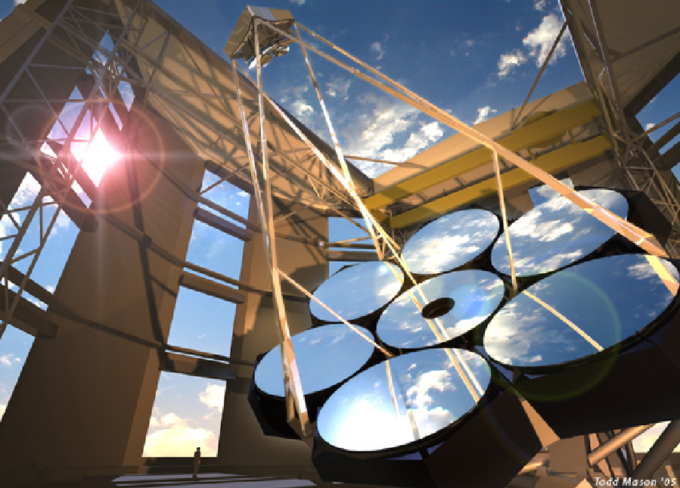
Extremely Large Telescopes (24-42 meters)
GMT=Seven mirrors, each 8.4m in diameter
TMT, EELT – segmented 30,42m aperture

Slide 38
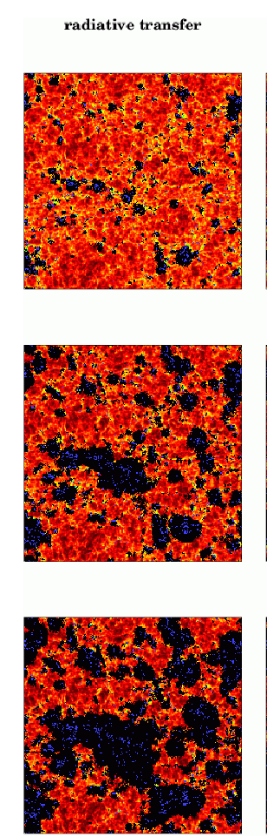
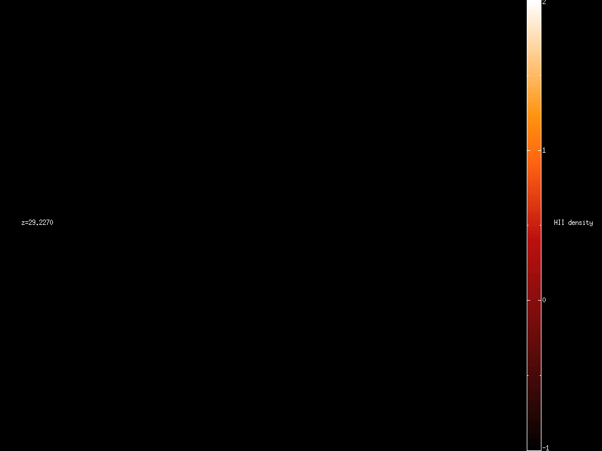
Reionization
HI Density
Z=8.16
x_HI(z)
Z=7.68
PopII/Pop III
T(z)
Z=6.89
Zahn et al. 2006
Trac, Cen, & Loeb 2008

Slide 39
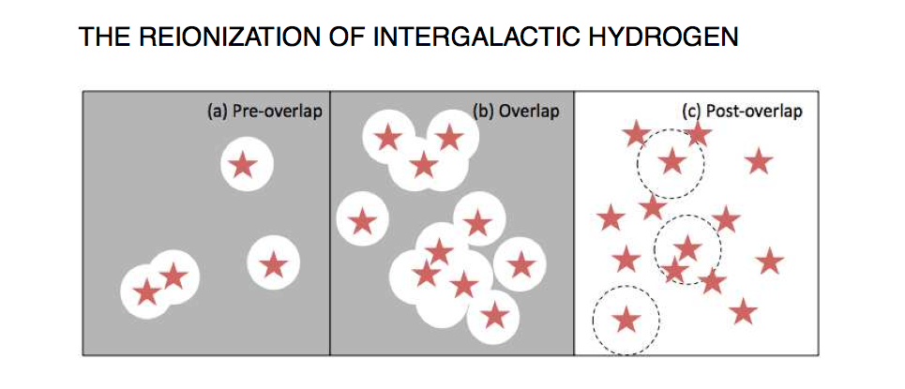
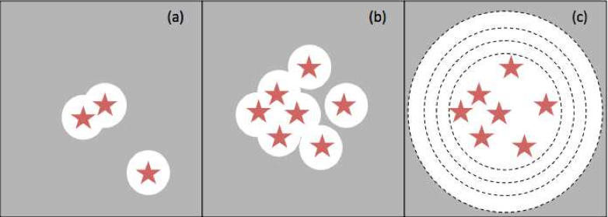
# ionizing photons = # H atoms

Slide 40
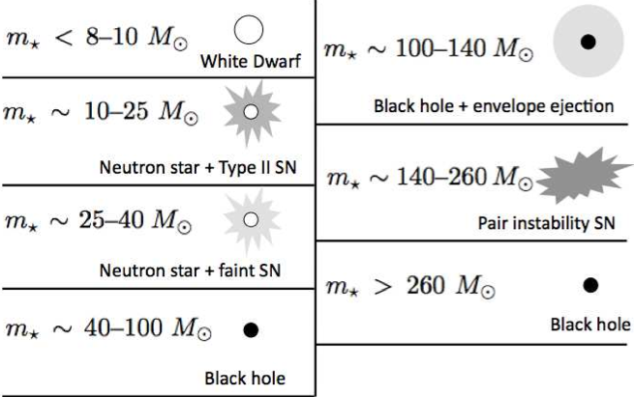
Stellar Remnants
Enrichment by >0.001 of solar metallicity: C+/O cooling is more effective than H_2 cooling: Pop III → Pop II (dust)

Slide 41
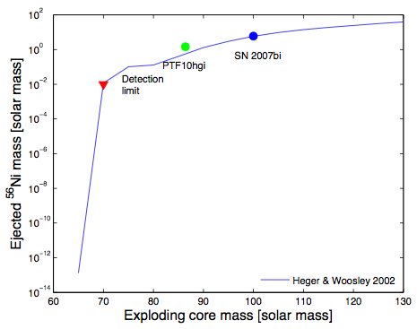

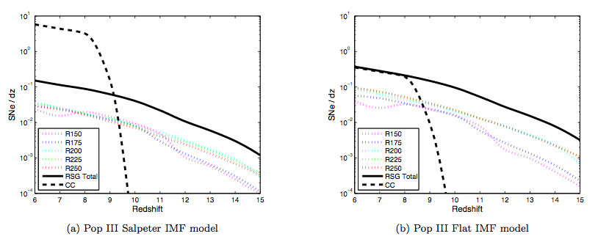

Pair Instability Supernovae
*Best understood SNe
*Examples are known up to z~4 (Cooke et al. 2012)
Gal-Yam 2012
JWST NIRCam, 10 arcsec^2, 8 hours (2nJy)
Pan, Kasen, & Loeb 2012
Pan, Kasen, & Loeb 2012

Slide 42





Farthest Superluminous Supernova
SN2213-1745 at z=2.05
SN1000-0216 at z=3.9=
Not Pop-III !
Cooke et al. , Nature (2012)

Slide 43



Long Gamma-Ray Bursts: Observing One Star at a Time
Collapse of a Massive Star (accompanied by a supernova )
Existing finder: Swift; Proposed: JANUS, EXIST (high-z GRBs)

Slide 44
A Bright Explosion 600 Million Years after the Big Bang
z~8.3

Slide 45


…and GRB 090429B at t=520 million years (z~9.4)
Cucchiara et al. (2011)

Slide 46
Observing the Diffuse Gas

Slide 47


Slide 48



So far, the intergalactic hydrogen was mainly probed by quasar spectra
Fan et al. 2005

Slide 49



10%
50%
100%
Nature (June 2011)

Slide 50



wavelength: 21 cm
Harvard connection: Theodore Lyman, Cecilia Payne-Gaposchkin, Edward Purcell , George Field …

Slide 51




Hydrogen
Mapping the Cosmic Distribution of
e-
p
Ground level
excitation rate= (Lya & atomic collisions)+(radiative coupling to CMB)
Couple to
Couples to
spin
p
e-
p
e-
Spin Temperature
Predicted by Van de Hulst in 1944; Observed by Ewen &Purcell in 1951

Slide 52
21cm Tomography of Ionized Bubbles During Reionization is like Slicing Swiss Cheese
H II
H I
Observed wavelength⬄ distance

Slide 53


21cm Mapping of Cosmic History in the 21st Century

Slide 54



Pritchard & Loeb 2012

Slide 55

21-cm Tomography throughout Cosmic History
temperatures
ionization fraction
emission
absorption
(Pritchard & Loeb, Phys. Rev. D, 2008)

Slide 56

Cosmological Evolution of the 21-cm Signal
Mesinger, Furlanetto, & Cen (2011)

Slide 57









Line-of-Sight Anisotropy of 21cm Flux Fluctuations
Peculiar velocity changes
→ Power spectrum is not isotropic (“Kaiser effect”)
observer
terms allow separation of powers
Barkana & Loeb 2004; see also Bharadwaj & Ali 2004

Slide 58
The Global 21-cm Signal
(Pritchard & Loeb, Phys. Rev. D, 2010)

Slide 59
The EDGES Experiment

Slide 60
Reionization Was Not Abrupt!
68%
95%
Bowman & Rogers 2010

Slide 61
Experiments
*LOFAR (Low-frequency Array)
Netherlands/Europe
*MWA (Murchison Wide-Field Array)
MIT/U.Melbourne,ATNF,ANU/CfA/Raman I.
*PAPER
UCB, South Africa
*21CMA (formerly known as PAST)
China
*GMRT (Giant Meterwave Radio Telescope)
India/CITA
*SKA (Square Kilometer Array)
International

Slide 62





Murchison Wide-Field Array: 21cm emission from diffuse hydrogen at z=6.5-15
4mx4m tiles of 16 dipole antennae, 80-300MHz
128 antenna tiles with total collecting area 2000 sq.m. at 150MHz across a 1.5km radius; few arcmin resolution

Slide 63
Foregrounds
Liu & Tegmark (2011)

Slide 64
Separating the Physics from the Astrophysics
Physics: initial conditions from inflation; nature of dark matter and dark energy
Astrophysics: consequences of star formation
Three epochs:
Before the first galaxies (z>25): mapping of density fluctuations through 21cm absorption
During reionization: anisotropy of the 21cm power spectrum due to peculiar velocities
After reionization (z<6): dense pockets of residual hydrogen (DLAs) trace large scale structure

Slide 65
Testing gravity: measuring the gravitational growth of perturbations on small scales (not probed so far) which are still in the linear regime at high redshifts (1<z<15)
Status: analogous to CMB research prior to COBE

Slide 66

When Was the Universe Ionized?
Zahn et al. 2012

Slide 67
Intensity Mapping of Other Lines (without resolving individual galaxies)

Slide 68

Galaxy surveys, Intensity Mapping and 21-cm Mapping

Slide 69

Other Emission Lines from Galaxies

Slide 70

Herschel Spectra

Slide 71


Slide 72


Slide 73
Cross-Correlation of Different Lines Removes Contamination from Other Redshifts
Visbal & Loeb (JCAP, 11, 1016, 2010); Visbal, Trac, & Loeb (2011)

Slide 74
Cross Correlating CO (galaxies) and 21-cm (HI)
size of ionized bubble
Lidz et al. (2011)

Slide 75


Gauging the Contribution of X-ray Sources to Reionization from the kSZ Signal
50% X-rays
no X-rays
Visbal & Loeb 2011

Slide 76
The Next Decade Promises to be Exciting!
Large-aperture infrared telescopes and radio arrays will image galaxies and the diffuse cosmic gas during the epoch of reionization. 21-cm brightness fluctuations are expected to be anti-correlated with infrared galaxies during reionization and correlated after reionization.
Adequate simulations of reionization are starting to employ sufficiently large (>100Mpc) boxes with the necessary spatial resolution to properly identify the ionizing sources.

Slide 78




When Was the Universe Ionized?
Based on Lya forest at z<6 and CMB data
Pritchard, Loeb, & Wyithe, arXiv:0908.3891

Slide 79


The Universe (14th Century, Monumental Cemetery, Pisa)
Not included in the Standard Model of Cosmology

Slide 80


Slide 81

Will JWST Resolve Galaxies at z~10?
(Wyithe & Loeb 2010)

Slide 82
First Stars Had High Spin
Sr and Y abundance in eight ~12Gyr old stars in NGC 6522 require a rotation speed of ~500 km/s (slow neutron capture is 10,000 more effective than in non-rotating stars).
Implications: rotational mixing, GRBs
Stacy, Bromm, & Loeb (2010)
Chiappini et al., Nature (2011)

Slide 83









Number of ionizing photons (>13.6eV) per baryon incorporated into stars:
Massive, metal free stars
Gain by up to a factor of ~30!
Metal free
Salpeter mass function
Bromm, Kudritzki, & Loeb 2001, ApJ, 552, 464

Slide 84





Threshold Metallicity
High mass (Pop-III) stars
Low mass (Pop-I/II) stars
Atomic cooling (CII, OI) →
Dust, molecules (CO) →
Milky-Way halo anemic stars:
but:

Slide 85


Low-Metallicity H II Regions with a ~ K Ionizing Continuum
z=3.357
Fosbury et al. (2003)
z=5.563
Raiter et al. (2003)

Slide 86



→Enrichment of Primordial Gas with Heavy Elements was Highly Inhomogeneous
z = 2.34
early enrichment
early enrichment
late enrichment
early Pop-III
late Pop-III
early Pop-III

Slide 87

SN 2007bi – a Pair Instability Supernova in a Nearby Metal-Poor Dwarf Galaxy
Nickel mass of ~4-7 (ejecta mass of 100 ) ; kinetic energy of
Dwarf galaxy at z=0.128 with M_B=-16.3 mag, and 12+[O/H]=8.25
Gal-Yam et al., Nature (arXiv:1001.1156 )

Slide 88

Cosmological Evolution of the 21-cm Signal
Mesinger et al. (2012)

