Slide 1
Lecture I: Structure Formation in the Universe
Avi Loeb
Harvard University

Slide 2
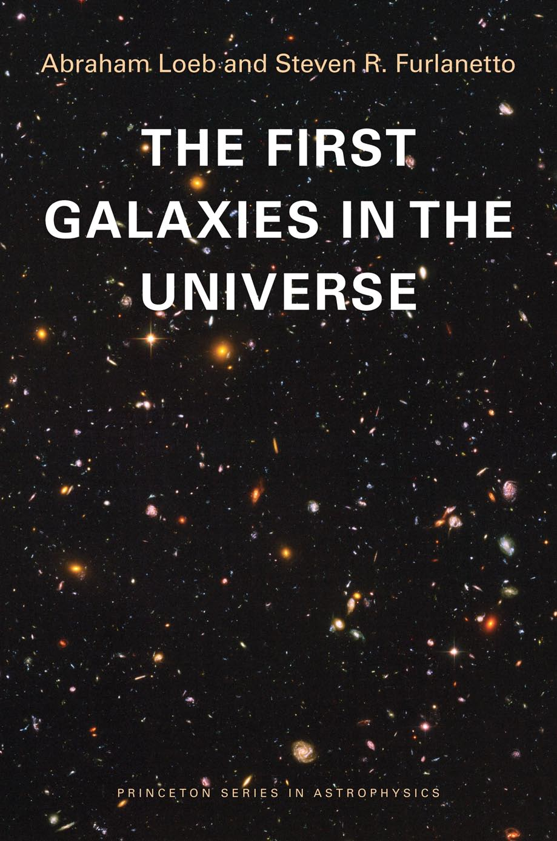

Slide 6
we are here

Slide 7
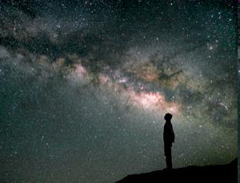
Cradle Mountain Lodge Tasmania, January 2008

Slide 8
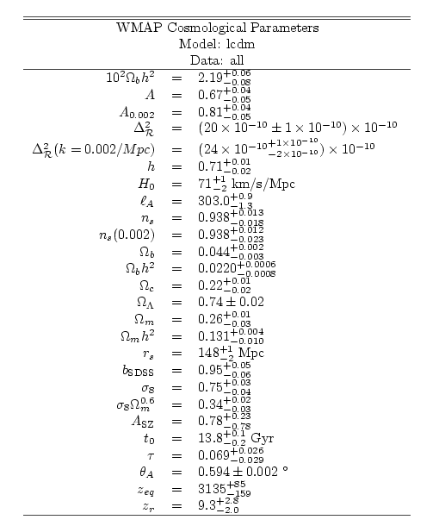
The initial conditions of the Universe can be summarized on a single sheet of paper, yet thousands of books cannot fully describe the complex structures we see today… Why?
Gravitational instability

Slide 9




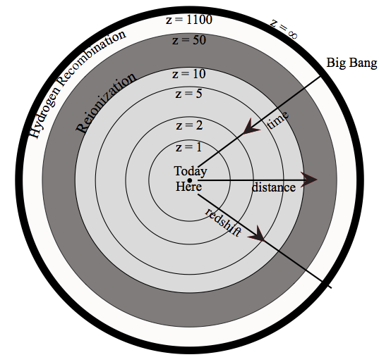
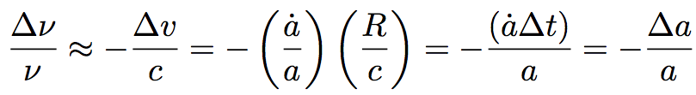




Standard Cosmological Model
On large scales: homogeneous and isotropic
Hubble expansion

Slide 10







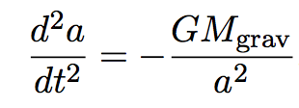




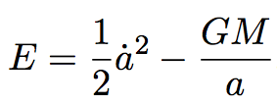


Expansion History
Gravitating mass density
Acceleration
a
Birkhoff’s theorem

Slide 11
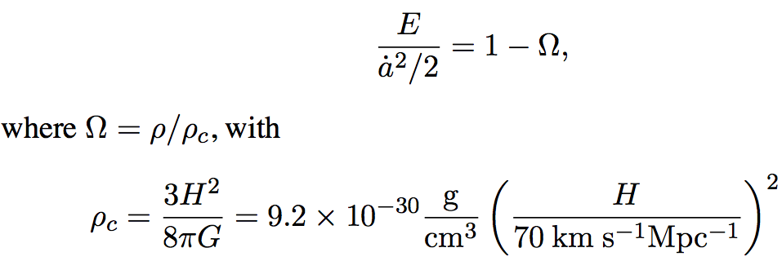

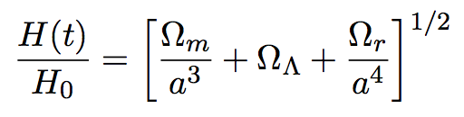
Expansion History
Hubble expansion rate
Vacuum domination:

Slide 12
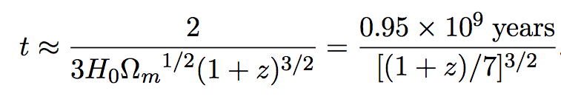
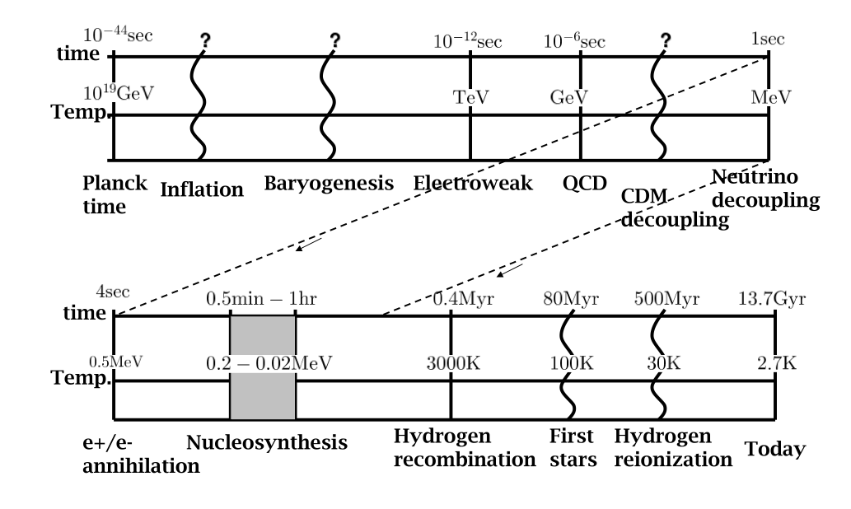
Thermal History
Age of the Universe at redshift 1<z<1000

Slide 13



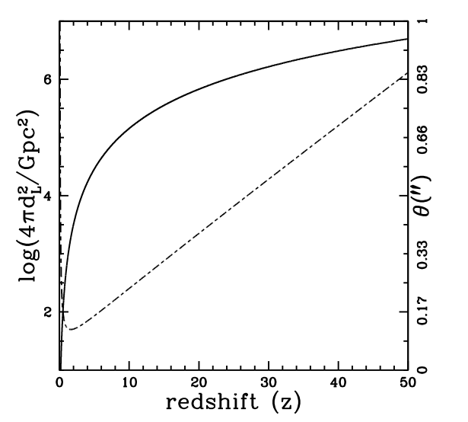
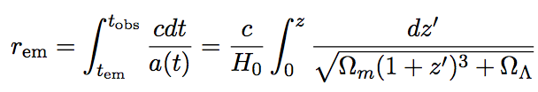
Distances
Luminosity distance: observed flux
=1kpc

Slide 14
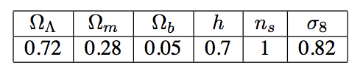
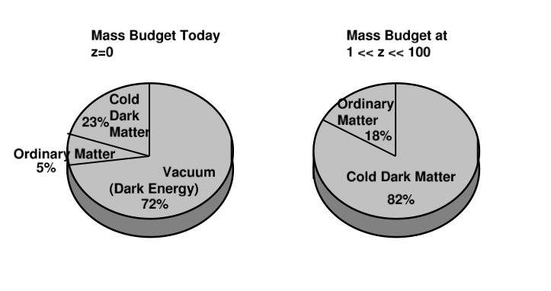
Parameters of the Standard Cosmological Model

Slide 15
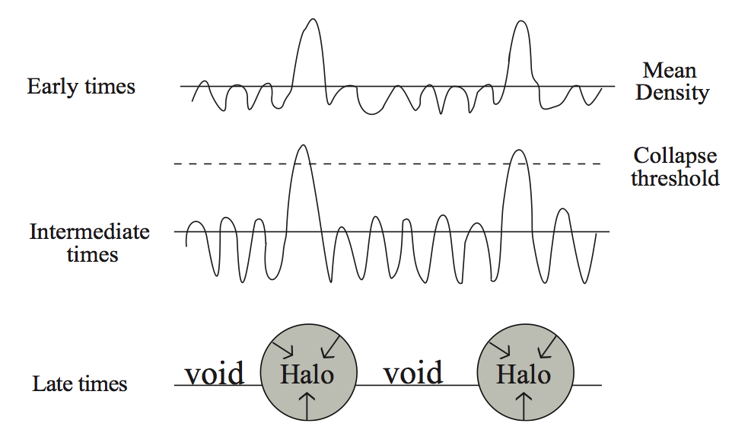
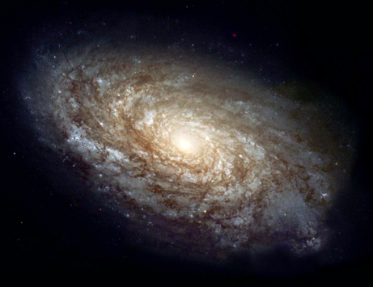
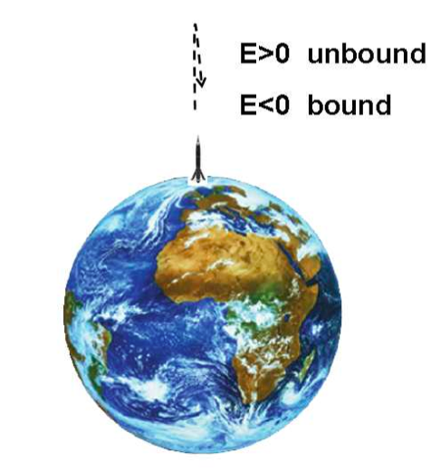
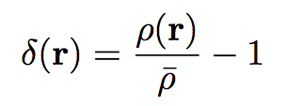
Growth of Density Perturbations

Slide 16
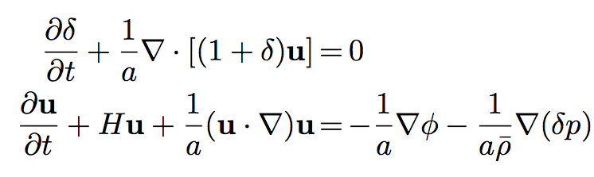

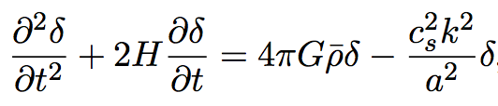
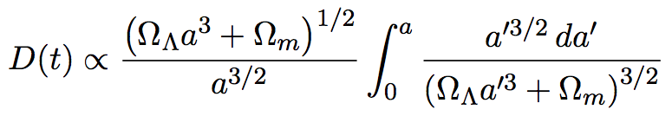


Linear (small) Perturbations
Pressure: zero for cold dark matter; finite for gas
Growth factor during matter domination (without pressure):
But only logarithmic growth during radiation domination ( )

Slide 17
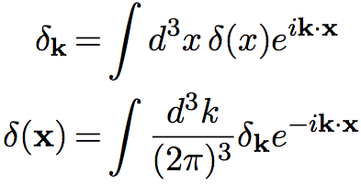


Fourier Space
Power spectrum:
With cold dark matter, turnover at matter-radiation equality:
(as expected from quantum fluctuations generated during a period of inflation with H=const and all modes exiting the horizon with the same amplitude)

Slide 18
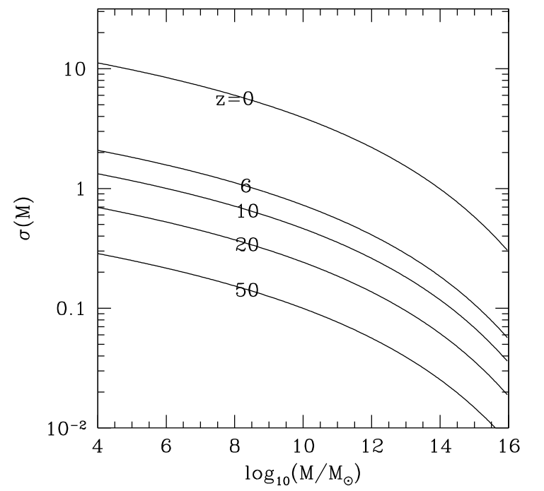
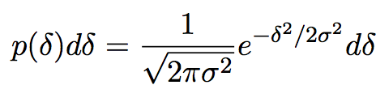
Amplitude of Density Perturbations

Slide 19
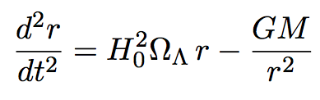
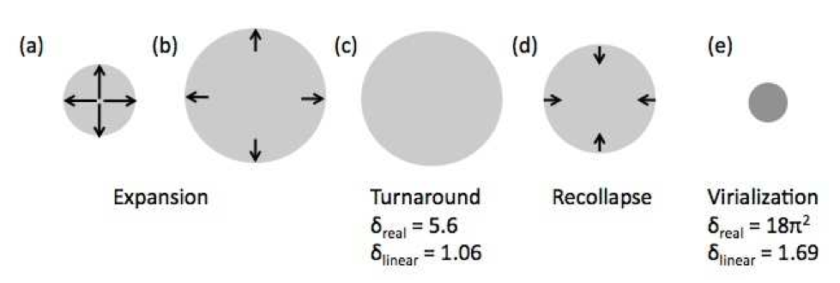
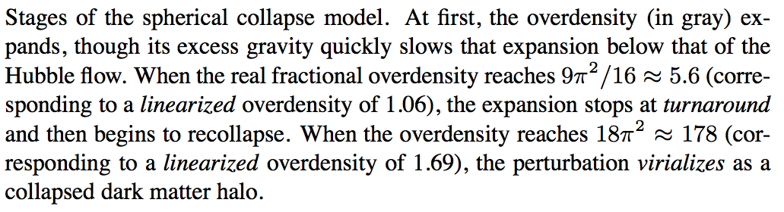

Nonlinear Spherical Collapse

Slide 20
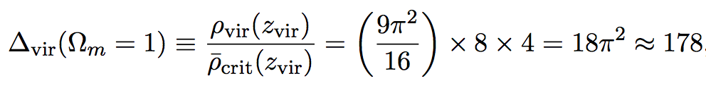
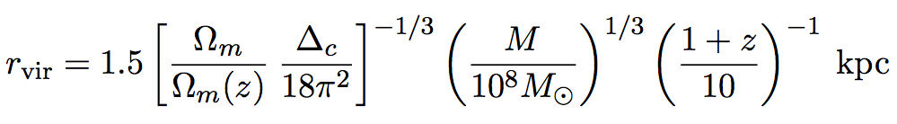
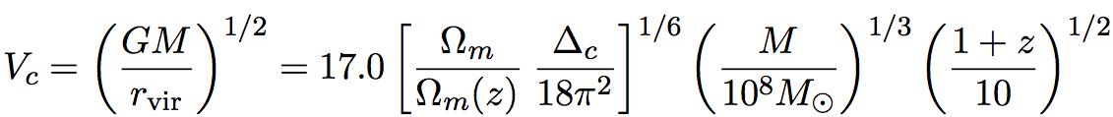

Properties of Dark Matter Halos
Density contrast at virialization
Halo radius
Circular velocity
Virial temperature

Slide 21
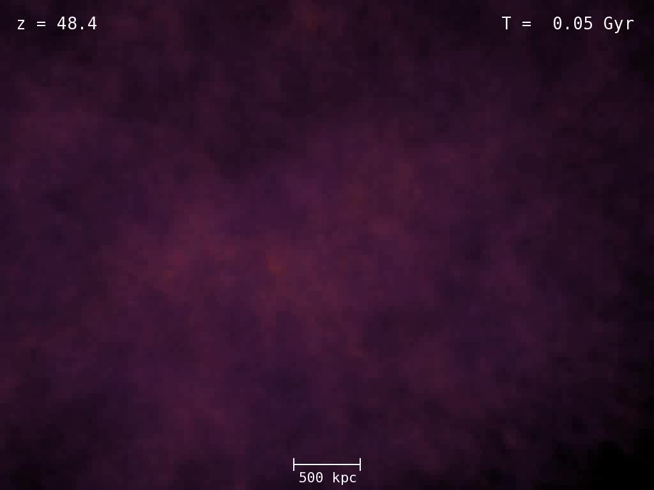
Aquarius N-body Simulation (Springel et al. 2011)

Slide 22
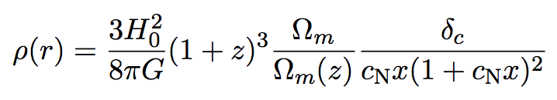

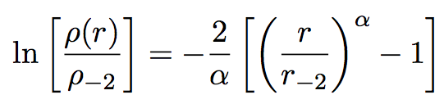
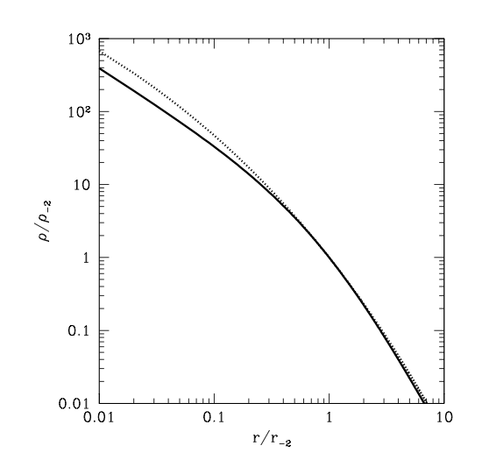


“Universal” dark matter density profile
NFW
Einasto
Radial orbit instability: isotropy below the half mass radius
Radial infall: slope should be sensitive to environment (-4 for an isolated halo)
(Visbal, Loeb, & Hernquist 2012)

Slide 23
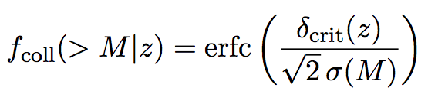
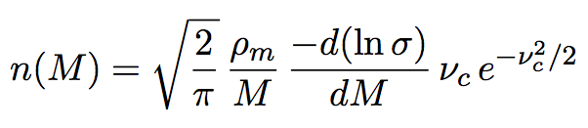

Abundance of Halos
Press-Schechter Model

Slide 24
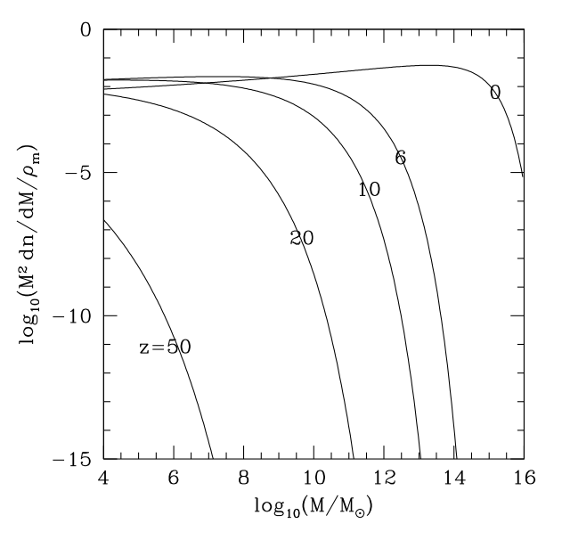
Halo mass budget

Slide 25
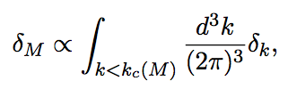
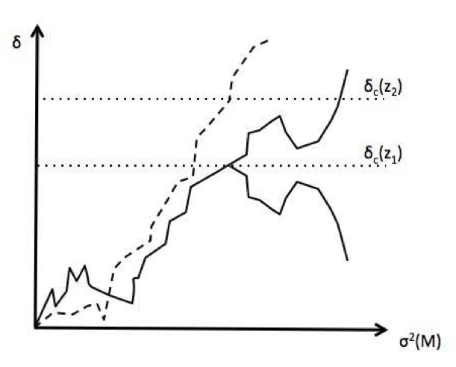
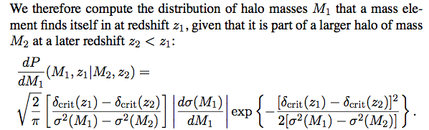
Excursion Set Formalism
Recovers missing factor of 2 in the Press-Schechter approach
large scales
small scales

Slide 26
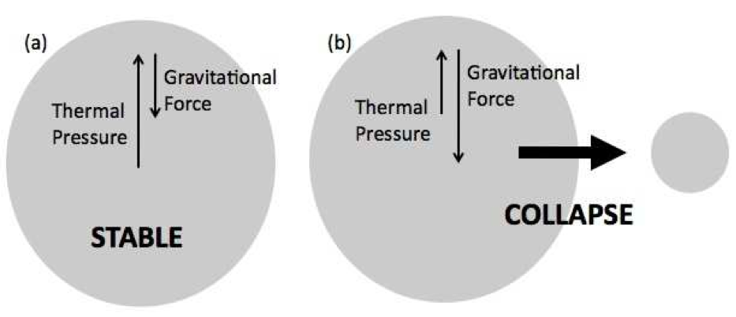
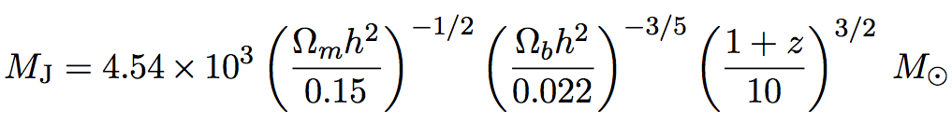

Gas Pressure
Jeans mass
Grows to ~10^9M. after intergalactic gas is photo-heated to ~10^4K

Slide 27
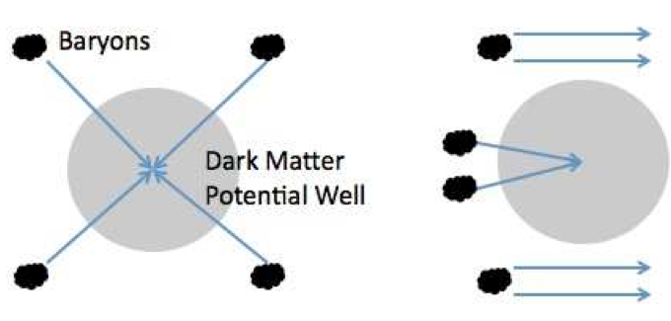

Streaming of baryons relative to Dark Matter
Fourier transform: acoustic oscillations (all harmonics)
Sound waves in the baryon-radiation fluid at z>1000, not shared by the dark matter (whose perturbations grow once matter dominates).
Without dark matter, photon diffusion would have erased small-scale fluctuations, galaxies would not form, and we would never exist.
Characteristic speed of “baryonic wind”: (30 km/s)x[(1+z)/1000], coherent in cells of a few cMpc.
Affects the assembly of gas into the lowest-mass halos with M<10^6M. at 10<z<50.
(Tseliakhovich & Hirata 2011)

Slide 28
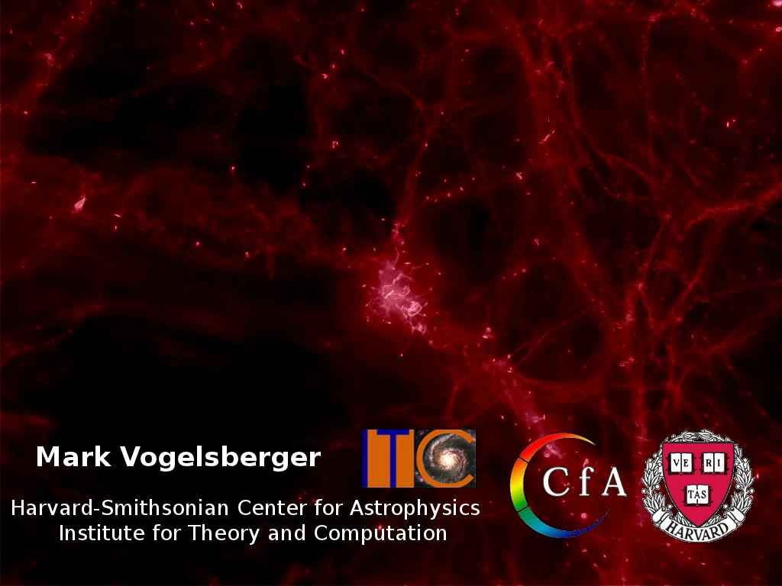
Hydrodynamic Simulation (AREPO, Vogelsberger et al. 2011)

Slide 29
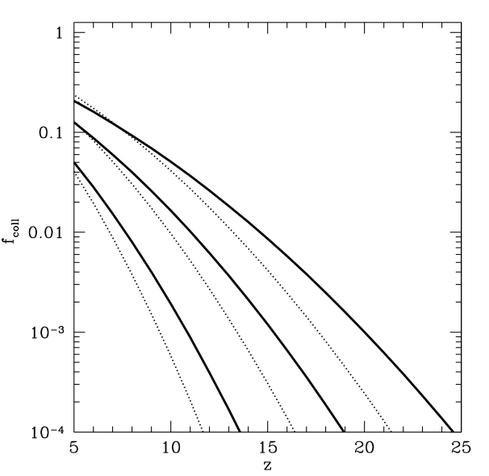

Fraction of collapsed matter

Slide 30
Cosmic-Archeology
Early time
redshift
today
distance
Earth
The more distant a source is, the more time it takes for its light to reach us. Hence, the light must have been emitted when the universe was younger. By looking at distant sources we can trace the history of the universe.

Slide 31
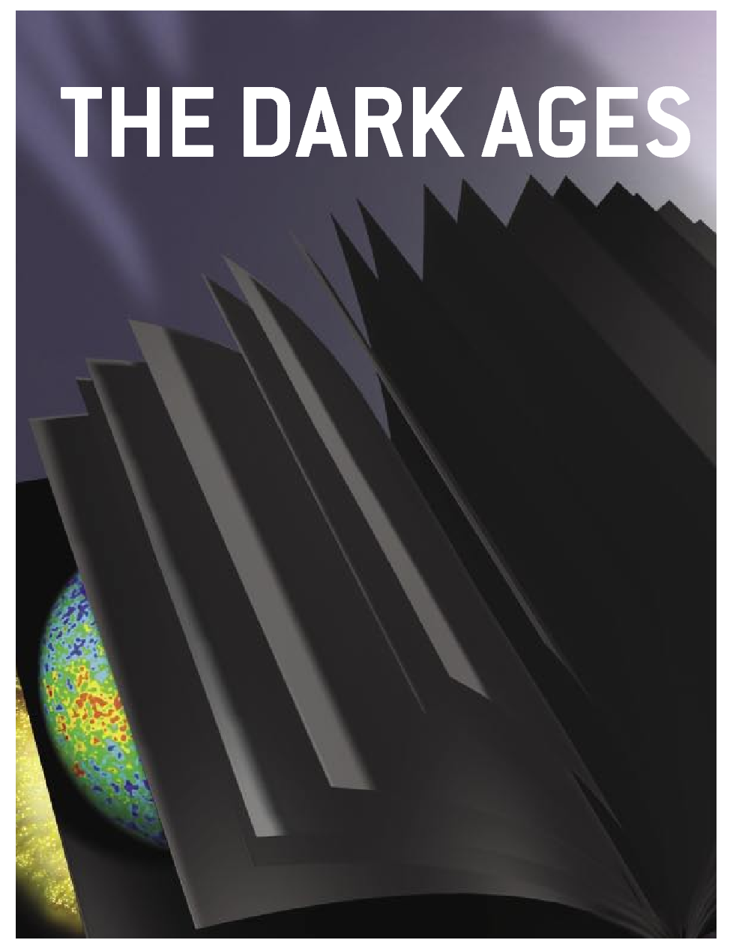
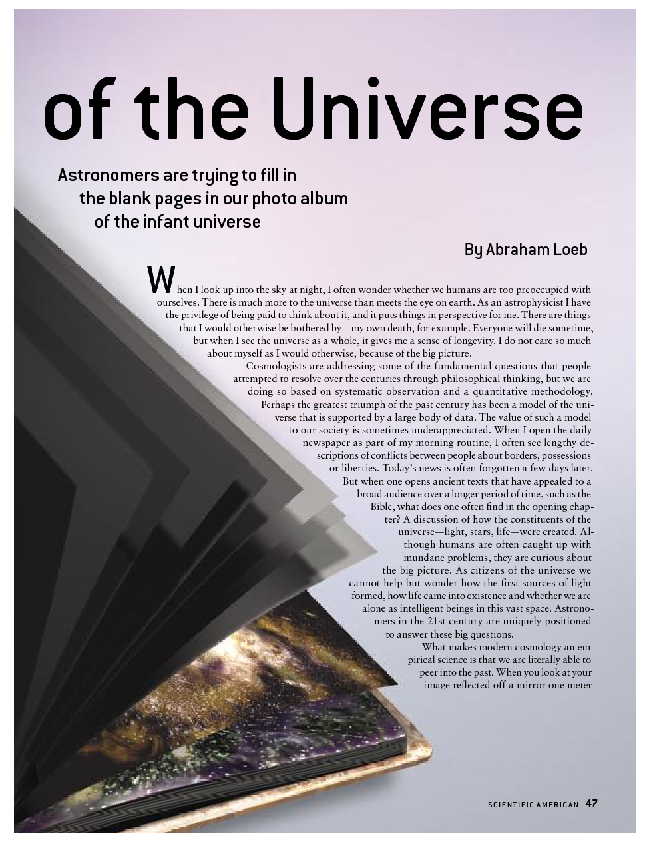

Slide 32
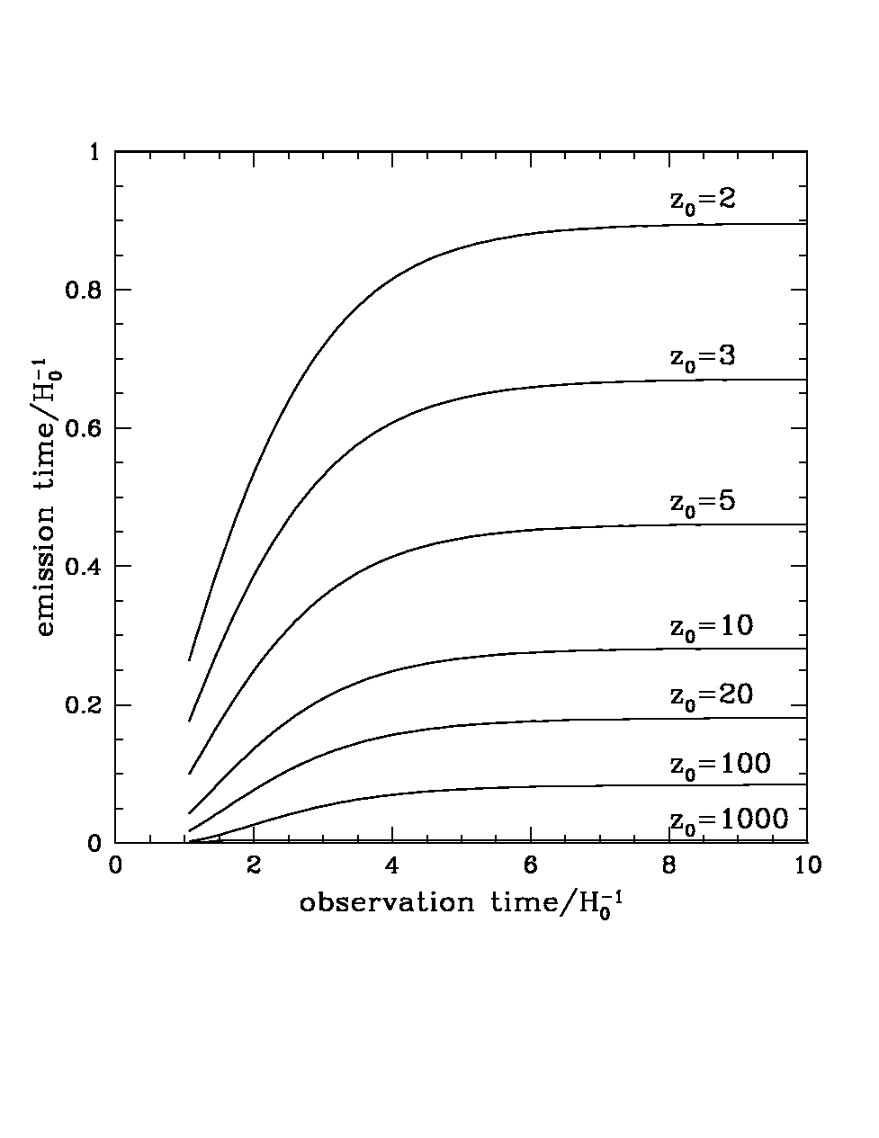
The Long Term Future of Extragalactic Astronomy
Accelerating
source
c
us
today
All galaxies beyond a redshift of z=1.8 are already outside our horizon (no cell phone communication to z>1.8!). (Loeb 2001)

Slide 33
Analogy
Ants = Photons Balloon=Expanding Space

Slide 34
Analogy
Ants = Photons Balloon=Expanding Space
visited area (horizon) since blowing started (Big Bang)

Slide 35
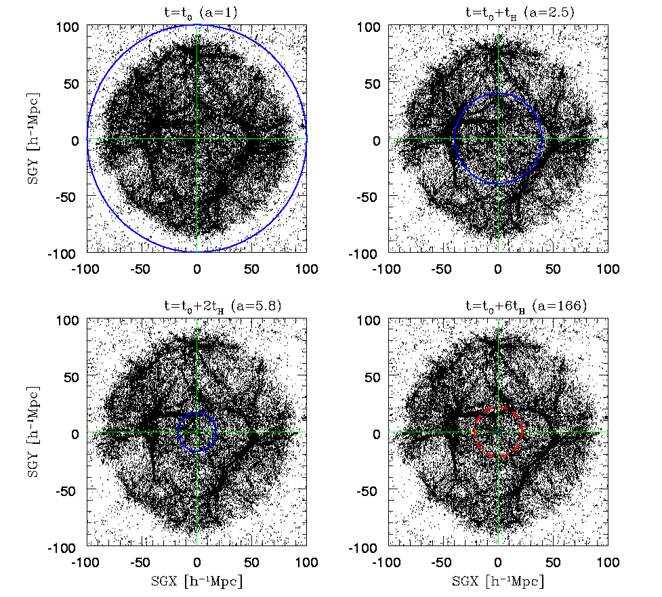
Future Evolution of Nearby Large-Scale Structure
Coma
Great Attractor
Perseus Pisces
us
100 cMpc
100 cMpc
horizon
100 cMpc
Nagamine & Loeb 2002,2003

Slide 36

How many galaxies will reside within our event horizon in 100 billion years?
Answer: one surrounded by vacuum
The merger product of the Andromeda and Milky-Way galaxies!

Slide 37
The Forthcoming Merger Between the Milky-Way and Andromeda: Milkomeda
The merger product is the only cosmological object that will be observable to future astronomers in 100 billion years
Collision will occur during the lifetime of the Sun
The night sky will change
Simulated with an N-body/hydrodynamic code (Cox & Loeb 2007)
The only paper of mine that has a chance of being cited in five billion years…

Slide 38


Slide 39

The Future Collision between the Milky Way and Andromeda Galaxies

Slide 40


Slide 41




Fate of the Sun

Slide 42
Highlights
Cosmologists are currently exploring the scientific version of the story of genesis (“let there be light”). Future observations will utilize large-aperture infrared telescopes (for imaging the first galaxies) and low-frequency radio arrays (for imaging cosmic hydrogen in between the galaxies).
Religious ideas about genesis are modified by science.
The merger product of the Milky-Way and Andromeda (Milkomeda ) is the only galaxy that will remain visible to us as the Universe ages by a factor of ten (a hundred billion years from now). Subsequent generations of observers will not be able to find direct evidence for the big bang.
Will cosmology turn into religion at that time?

Slide 43
Once the Universe ages by ~100 (a trillion years from now), the wavelength of the microwave background will exceed the scale of our horizon…
At that time, all extragalactic atoms will be pushed out of the horizon and be unavailable for tracing the cosmic expansion…

Slide 44

But our galaxy ejects hypervelocity stars!
SgrA*
Measure the vacuum mass density from the acceleration of hypervelocity stars that escape from Milkomeda
Estimate matter density when Milkomeda formed from the mean density of Milkomeda
Calculate time from the Big Bang based on the the measured ages of Milkomeda’s stars
Infer microwave background temperature from light element abundances
VALIDATE ancient cosmology textbooks
(Loeb 2011, arXiv:1102.0007)

Slide 45

The Visible Universe
z>5: most comoving volume (best statistical constraints on high k-modes)

Slide 46


The Universe (14th Century, Monumental Cemetery, Pisa)
Not included in the Standard Model of Cosmology

Slide 47
The Visible Universe

Slide 48


Slide 49





Cumulative Fraction of Comoving Volume
Loeb & Wyithe PRL (2008)

Slide 50




The Optimal Cosmic Time for Constraining the Initial Density Perturbations

Slide 51




The Optimal Cosmic Epoch for Precision Cosmology
The best constraints on the cosmological initial conditions can be obtained during the epoch of reionization, at z~10 (Lecture II)

