Slide 1
Basic Atmospheric Properties
Notes:
Go through some things that you have probably heard about 1000 times
Use as an opportunity to revise some basic scientific concepts that may be useful later

Slide 2
Goals
Derive the pressure and temperature structure of the atmosphere
Discuss the solar radiation budget
Discuss Earth’s orbit and the seasons
Notes:
Best summary of what an air parcel is. Credit R Fovell (UCLA)

Slide 3
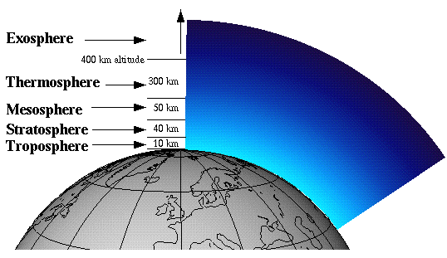
Air Parcel Definition
A parcel made by gathering together an unspecified amount of air. We pretend the air is surrounded by an invisible boundary
Parcel is SEALED from outside air (no mass exchange)
Parcel is INSULATED from surrounding environment (no heat exchange)
Parcel boundaries are FLEXIBLE (pressure inside parcel will change to match the pressure of its environment)
Notes:
Air parcel is a very useful concept for in general for atmospheric science
Best summary of what an air parcel is. Credit R Fovell (UCLA)

Slide 4
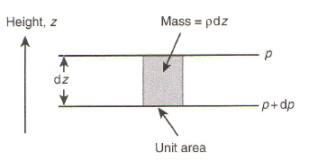
Hydrostatic Balance
With the help of an air parcel, we can determine the relationship between pressure and height in the atmosphere
Consider the major forces on an air parcel at rest
Notes:
Read Preamble
Explain diagram.
Ask about governing forces

Slide 5
Hydrostatic Balance
With the help of an air parcel, we can determine the relationship between pressure and height in the atmosphere
Consider the major forces on an air parcel at rest
gravity
F_{p}(z+dz) = p(z+dz) dA
F_{g}(z) = g ρ(z)dAdz
F_{p}(z) = p(z) dA
Pressure Gradient
At hydrostatic equilibrium the pressure gradient + gravitation forces balance

Slide 6
Hydrostatic Balance
Local air density can be found using the ideal gas law (pV=nRT)
M_{air} – Molecular Weight of air
R – Universal Gas Constant
T(z) – Temperature
N - # of moles of air
Substituting this into the hydrostatic balance equation
We can integrate this equation by assuming some mean temperature
NB – In practice this mean temperature approximation works well considering T is in Kelvin. In this scale the range of atmospheric temperatures is not too different…

Slide 7
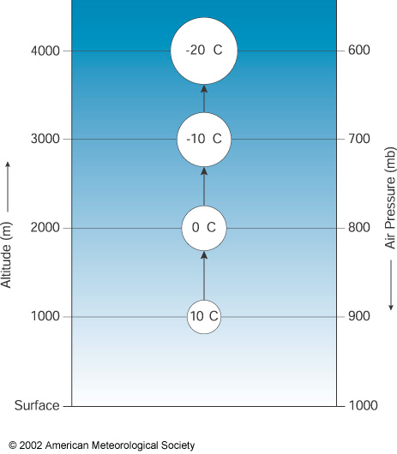
Dry Adiabatic Lapse Rate
What happens to an air parcel if we lift it?
As the parcel is lifted the pressure in the surrounding environment decreases
The parcel equilibriates to the pressure of its environment by expanding.
This expansion takes energy (work). Consequently the parcel must cool(conservation of energy)

Slide 8
Dry Adiabatic Lapse Rate
By how much does it cool?
Lets look at the energy budget. From the first law
V+dV
Internal Energy
Heat
Work
Consider a parcel with mass m
How much does the temperature change moving from z to z+dz?
p_{env}(z+dz)
V
p_{env}(z)

Slide 9
Dry Adiabatic Lapse Rate
By how much does it cool?
Lets look at the energy budget. From the first law
Internal Energy
Heat
Work
Consider a parcel with mass m
Adiabatic Process => no heat exchange => dq = 0

Slide 10
Dry Adiabatic Lapse Rate
By how much does it cool?
Lets look at the energy budget. From the first law
Internal Energy
Heat
Work
Consider a parcel with mass m
Adiabatic Process => no heat exchange => dq = 0
Work done by parcel expanding = pdV =>dw = -pdV

Slide 11
Dry Adiabatic Lapse Rate
By how much does it cool?
Lets look at the energy budget. From the first law
Internal Energy
Heat
Work
Consider a parcel with mass m
Adiabatic Process => no heat exchange => dq = 0
Work done by parcel expanding = pdV =>dw = -pdV
Change in internal energy dU = mc_{v}dT

Slide 12
Dry Adiabatic Lapse Rate
By how much does it cool?
Lets look at the energy budget. From the first law
Internal Energy
Heat
Work
Consider a parcel with mass m
Adiabatic Process = no heat exchange => dq = 0
Work done by parcel expanding = pdV =>dw = -pdV
Change in internal energy dU = C_{v}dT

Slide 13
Dry Adiabatic Lapse Rate
With the help of the ideal gas law we can get rid of dV
Hydrostatic Balance:
Definitions of ideal gas law/heat capacity
,

Slide 14
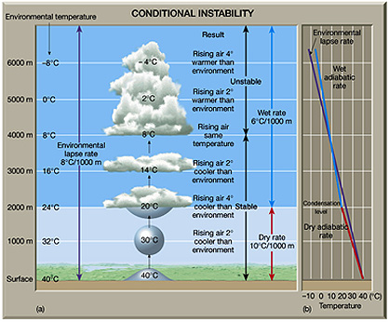
Environmental Lapse Rate
But we forgot about water vapor
As an air parcel rises and cools, the maximum amount of water vapor it can hold decreases (this is governed by the Claussius-Clapyron equation)
At some point (called the lifting condensation level) water vapor will start to condense and release latent heat
This results in a lower lapse rate than predicted by the DALR
On average, typical lapse rates observed in the atmosphere are ~6.5K/km

Slide 15
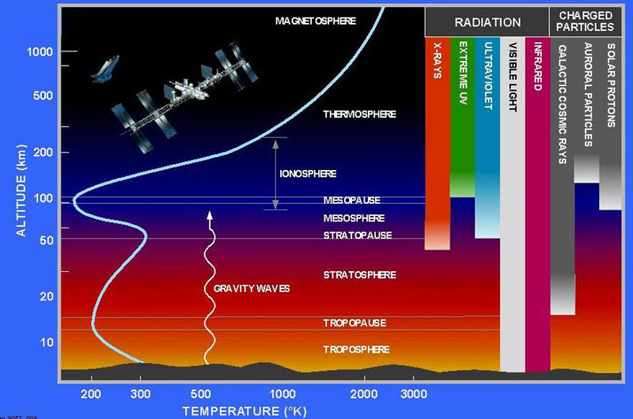
Temperature Structure of Earths Atmosphere
Troposphere – Temperature decreases with height due to thermodynamic lapse rate
Stratosphere – Temperature Increases with height due to ozone absorption of UV
Mesosphere – Where the thermodynamic lapse rate takes over again
Thermosphere – Temperature increases with height due to absorption by O2

Slide 16
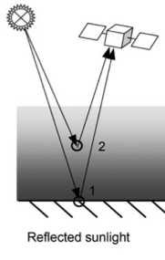
The Solar Radiation Budget
What are the sources of light reaching a detector? Lets first consider solar radiation
Notes:
Important processes in atmosphere
Scattering – Rayleigh (molecules), Mie (particles clouds) Geometric (Dust) …(size parameter)
Absorption – Gases particles (eg black carbon, dust)
Reflection – Surface – Specular (smooth surfaces) Lambertian (same radiance from every direction)

Slide 17
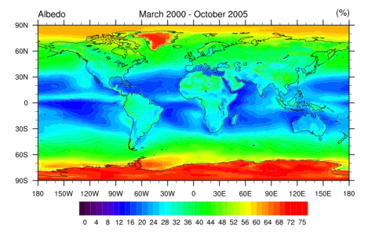
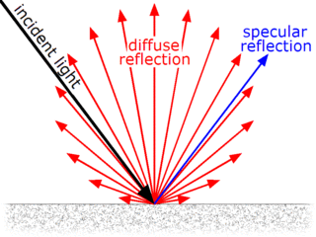
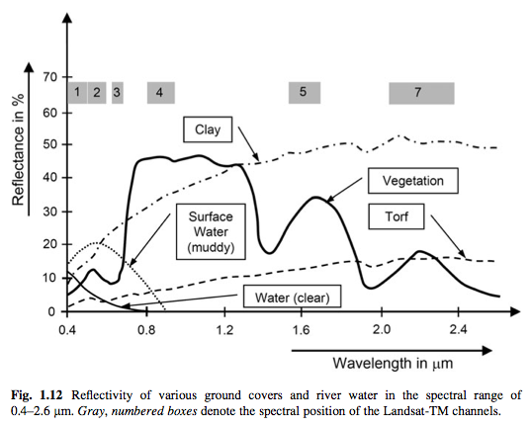
The Solar Radiation Budget
What are the sources of light reaching a detector? Lets first consider solar radiation
Surface Reflection
Total Radiation
Albedo – outgoing:incoming solar radiation flux
Distribution of Radiation
Smooth surfaces = specular
Rough surfaces = lambertian (has the same apparent brightness in every direction)
In general, the angles of reflectance are defined by a BRDF
Wavelength Dependence
In general the reflectivity of a surface depends on wavelength
Notes:
Important processes in atmosphere
Scattering – Rayleigh (molecules), Mie (particles clouds) Geometric (Dust) …(size parameter)
Absorption – Gases particles (eg black carbon, dust)
Reflection – Surface – Specular (smooth surfaces) Lambertian (same radiance from every direction)

Slide 18
The Solar Radiation Budget
Atmospheric Scattering
Any process that changes the direction of incident light
Due to interaction of radiation with dipoles of molecules or particles
How light scatters depends on the size of the scatterer relative to incident wavelength of light. This can be measured by a dimensionless size parameter (x)
Notes:
Scattering – Any process that redirects incident light
Matter consists of a bunch of electric charges (dipoles) that oscillate with an applied electric field, causing them to radiate EM waves
What is observed is therefore the superposition of the incident field + the field generated by the oscillating dipole

Slide 19
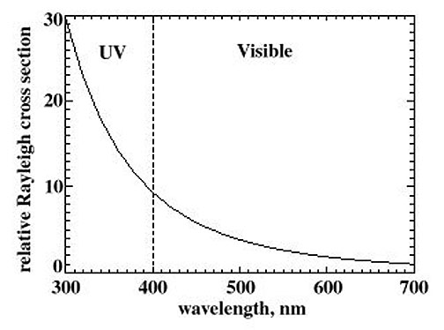
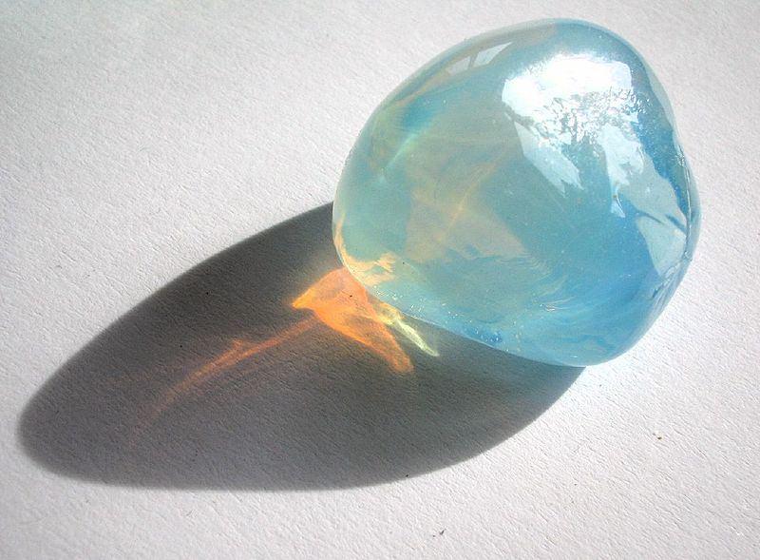
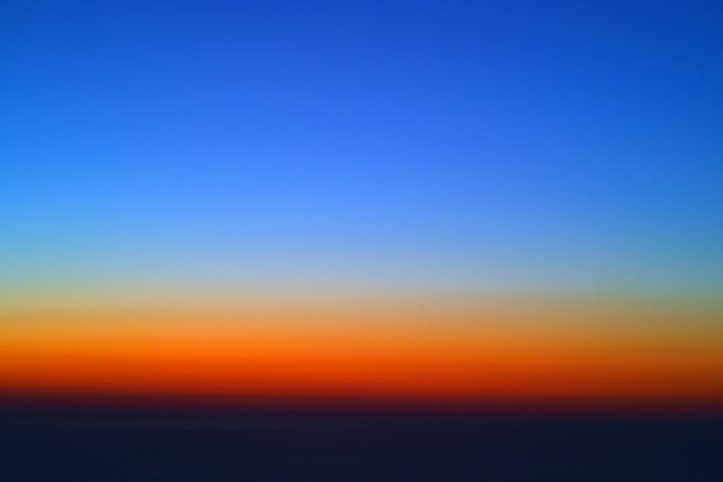
The Solar Radiation Budget
Atmospheric Scattering
Rayleigh Scattering
Occurs for x<< 1
In the atmosphere this is due to molecules
Scattering intensity has a 1/λ⁴ wavelength dependence
Notes:
Scattering – Any process that redirects incident light
Matter consists of a bunch of electric charges (dipoles) that oscillate with an applied electric field, causing them to radiate EM waves
What is observed is therefore the superposition of the incident field + the field generated by the oscillating dipole

Slide 20
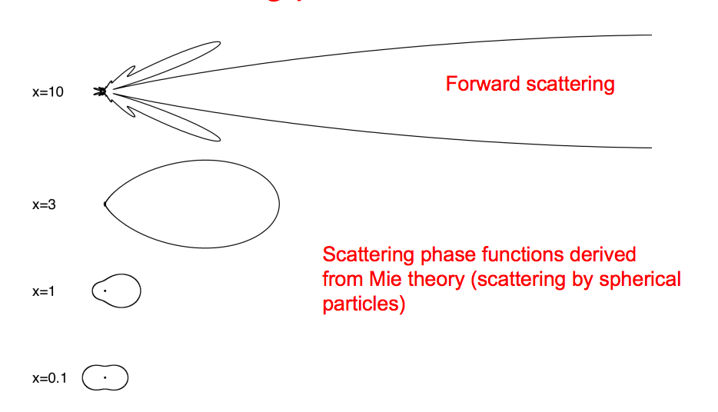
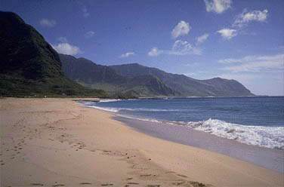
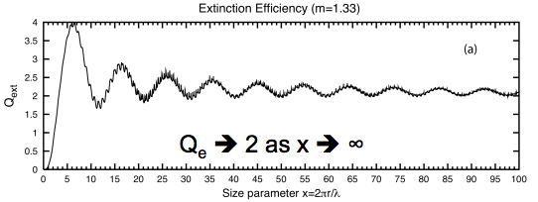
The Solar Radiation Budget
Atmospheric Scattering
Mie Scattering
Occurs for x ~ 1
Due to clouds (5-50 μm) and aerosols (0.1-1μm)
Higher proportion of light scattered forward for larger size parameters
Notes:
Scattering – Any process that redirects incident light
Matter consists of a bunch of electric charges (dipoles) that oscillate with an applied electric field, causing them to radiate EM waves
What is observed is therefore the superposition of the incident field + the field generated by the oscillating dipole

Slide 21
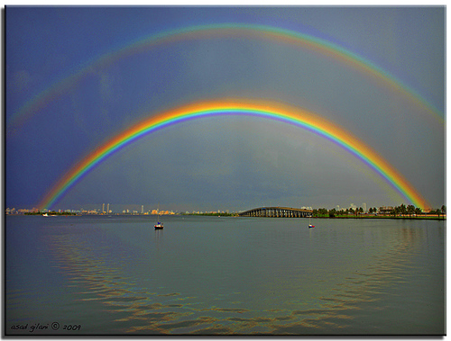
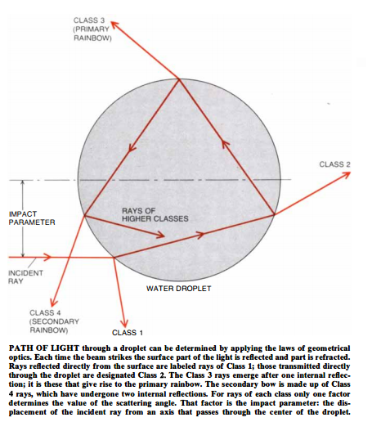
The Solar Radiation Budget
Atmospheric Scattering
Geometric Scattering
Occurs for x >> 1
Can describe light propogation with ray optics (reflection,refraction)
Notes:
Scattering – Any process that redirects incident light
Matter consists of a bunch of electric charges (dipoles) that oscillate with an applied electric field, causing them to radiate EM waves
What is observed is therefore the superposition of the incident field + the field generated by the oscillating dipole

Slide 22
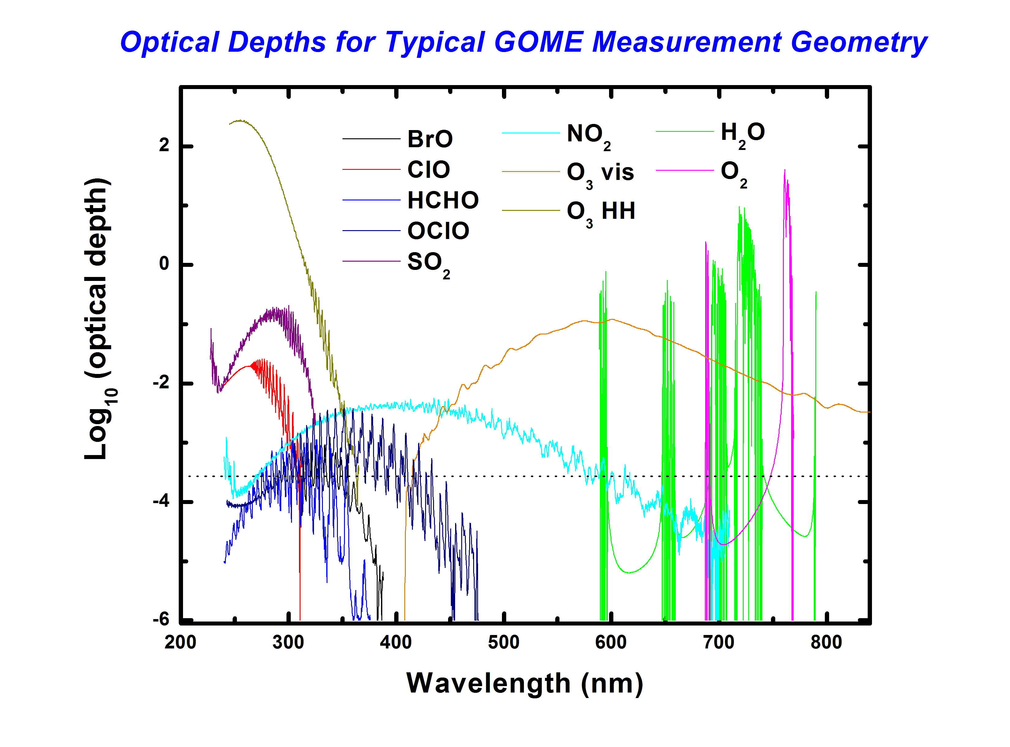
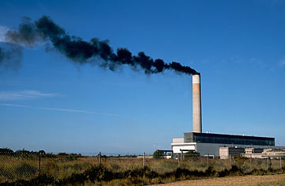
The Solar Radiation Budget
Atmospheric Absorption
By Molecules
From rotational/vibrational/electronic transitions
In Visible typically small ~1%
Strong absorption by ozone in the UV
By Aerosols
Predominantly black carbon and dust
Notes:
Scattering – Any process that redirects incident light
Matter consists of a bunch of electric charges (dipoles) that oscillate with an applied electric field, causing them to radiate EM waves
What is observed is therefore the superposition of the incident field + the field generated by the oscillating dipole

Slide 23
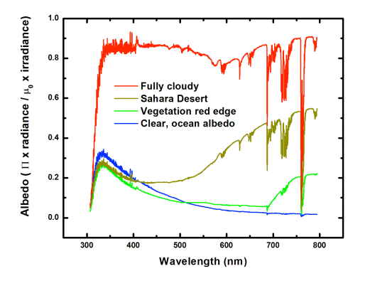
The Solar Radiation Budget
Now we can explain the shapes of these spectra…
Notes:
Scattering – Any process that redirects incident light
Matter consists of a bunch of electric charges (dipoles) that oscillate with an applied electric field, causing them to radiate EM waves
What is observed is therefore the superposition of the incident field + the field generated by the oscillating dipole

Slide 24
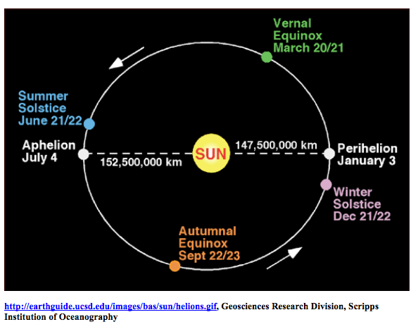
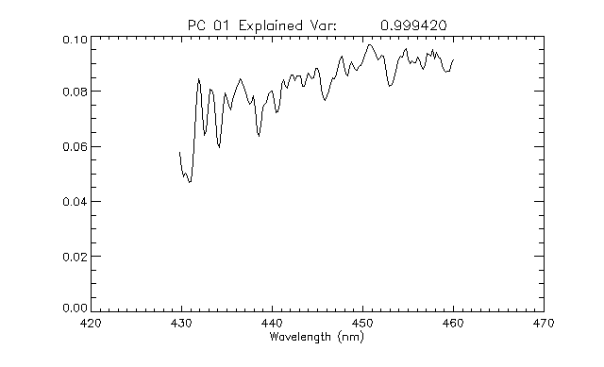
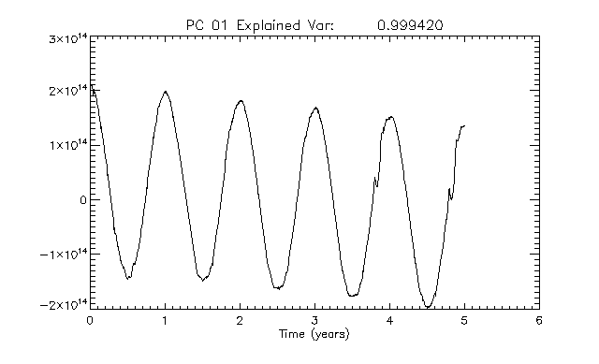
Earths Orbit
Earth orbits sun with slightly elliptical orbit (eccentricity = 0.0167)
Perihelian – Closest point to the sun
Aphelian – Farthest point from the sun
Real life Consequence: PCA analysis of OMI Solar Spectra (2004-2009)
Dominant PC looks like solar spectrum
Seasonal cycle associated with distance from sun (and detector degradation)
Notes:
Scattering – Any process that redirects incident light
Matter consists of a bunch of electric charges (dipoles) that oscillate with an applied electric field, causing them to radiate EM waves
What is observed is therefore the superposition of the incident field + the field generated by the oscillating dipole

Slide 25
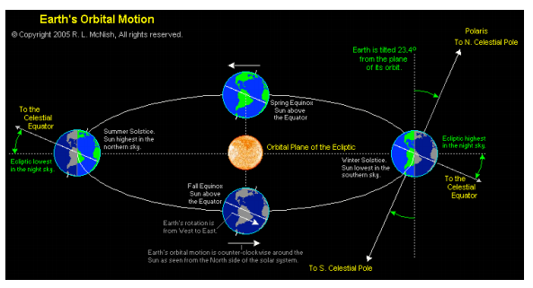
Earths Orbit
Ecliptic – Plane of Earth’s orbit around Sun
Obliquity – The angle between the ecliptic and Earth’s rotational axis
Obliquity determines the Earth’s seasons
Why we care? The SZA is linked to seasons, and it’s a really important factor for instrument sensitivity
Notes:
Scattering – Any process that redirects incident light
Matter consists of a bunch of electric charges (dipoles) that oscillate with an applied electric field, causing them to radiate EM waves
What is observed is therefore the superposition of the incident field + the field generated by the oscillating dipole

