Slide 1
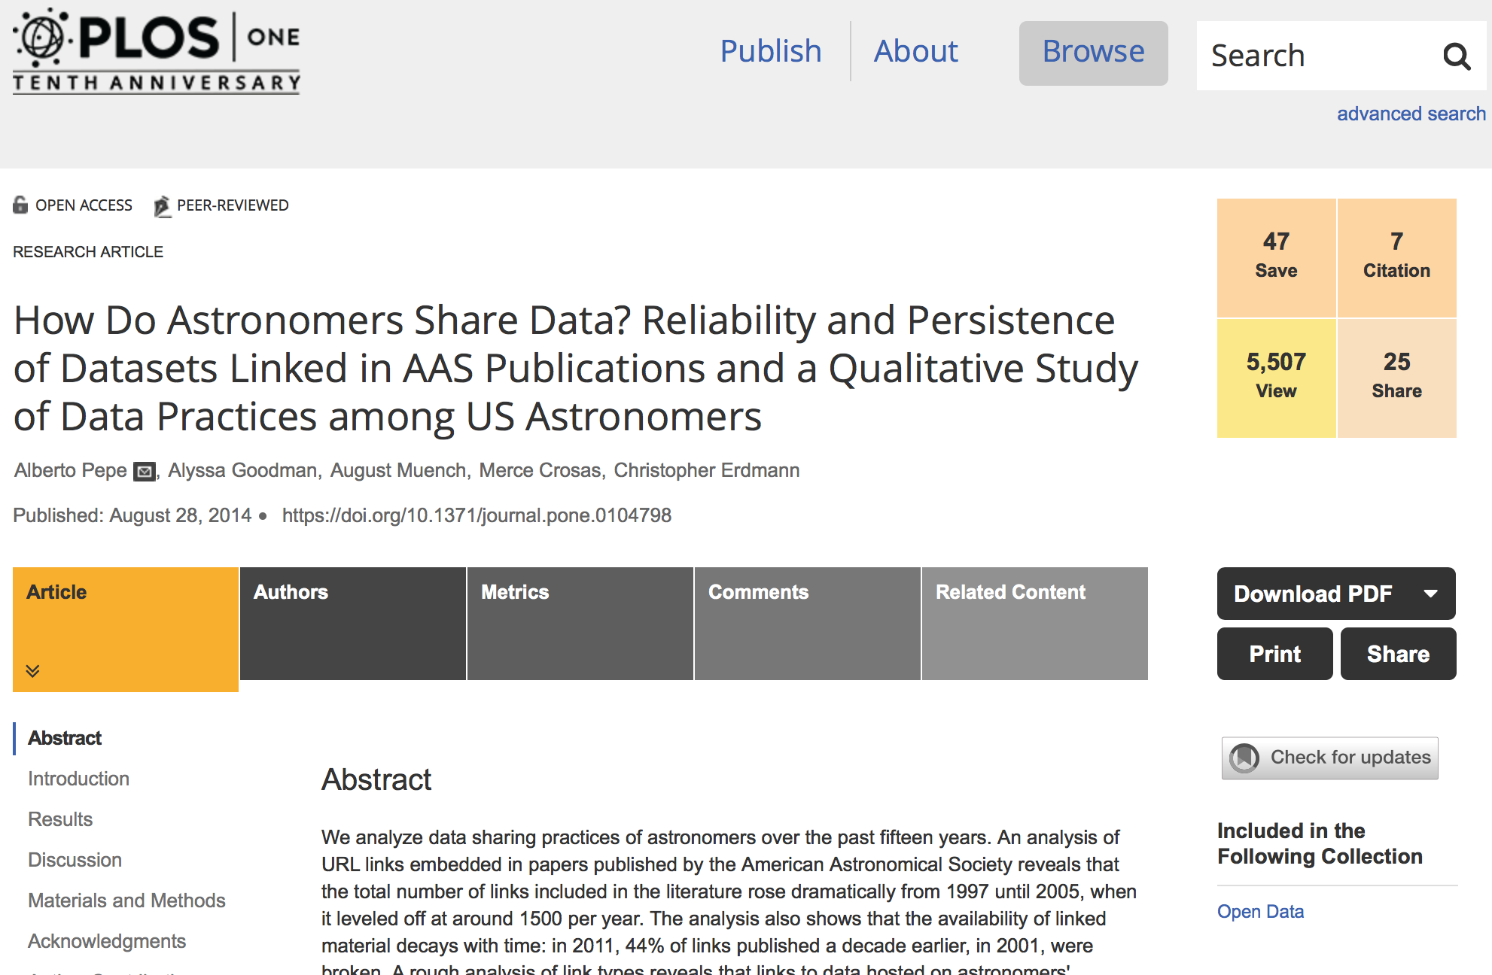
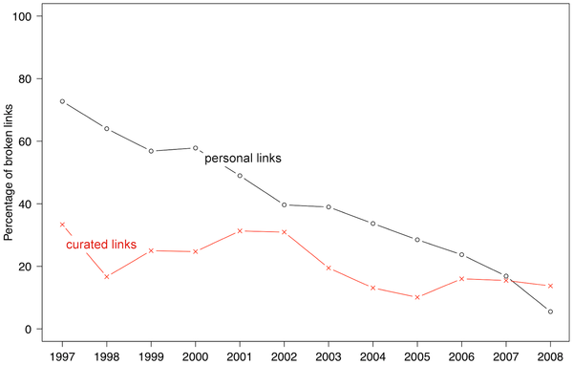
Percentage of broken links in astronomy publications according to type of website.
Pepe A, Goodman A, Muench A, Crosas M, Erdmann C (2014) How Do Astronomers Share Data? Reliability and Persistence of Datasets Linked in AAS Publications and a Qualitative Study of Data Practices among US Astronomers. PLOS ONE 9(8): e104798. https://doi.org/10.1371/journal.pone.0104798
http://journals.plos.org/plosone/article?id=10.1371/journal.pone.0104798

Slide 2
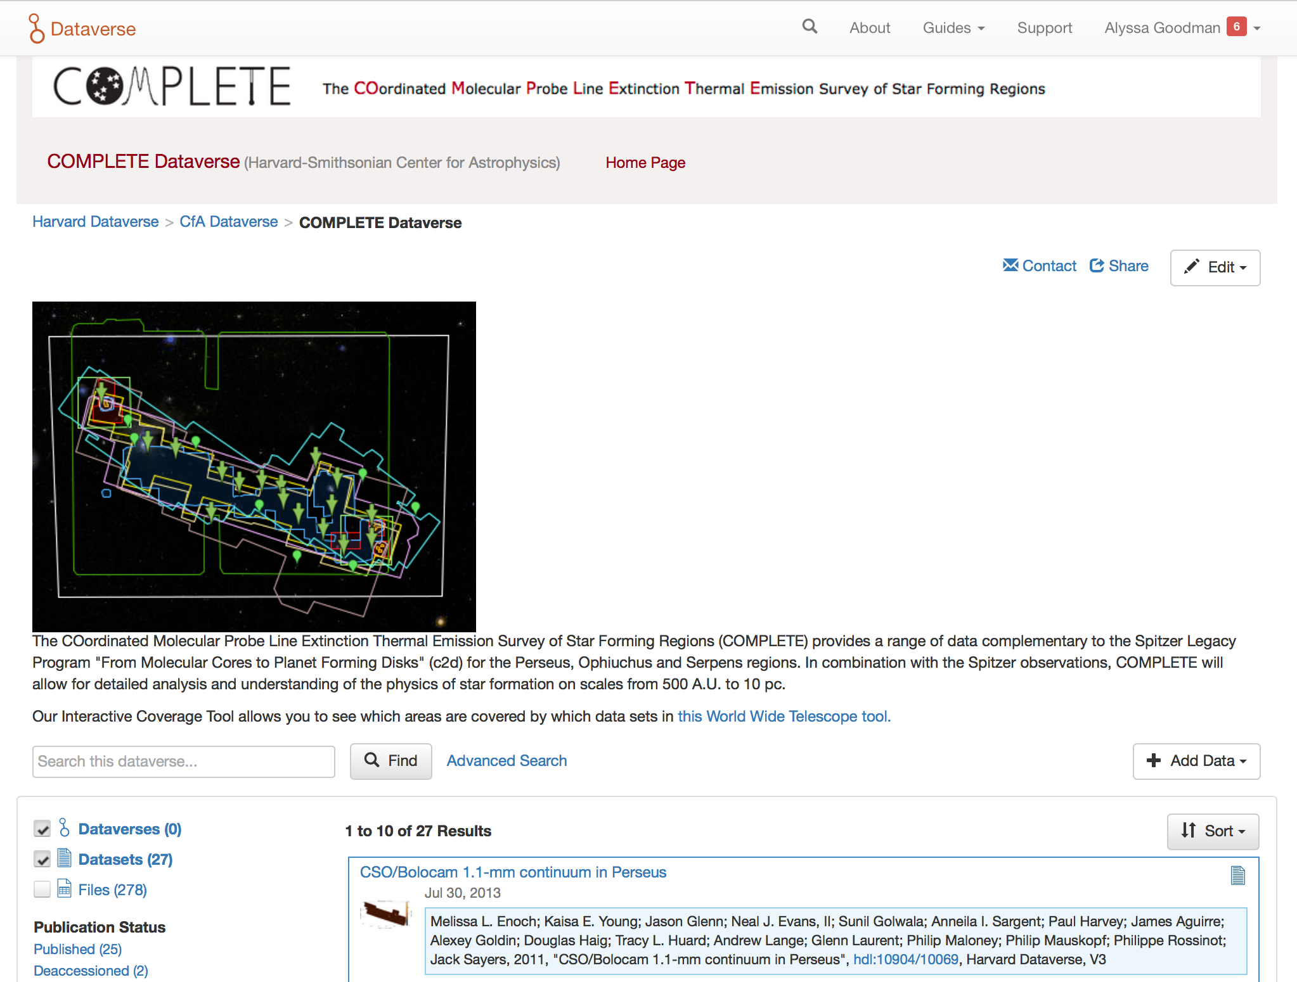
https://dataverse.harvard.edu/dataverse/complete

Slide 3
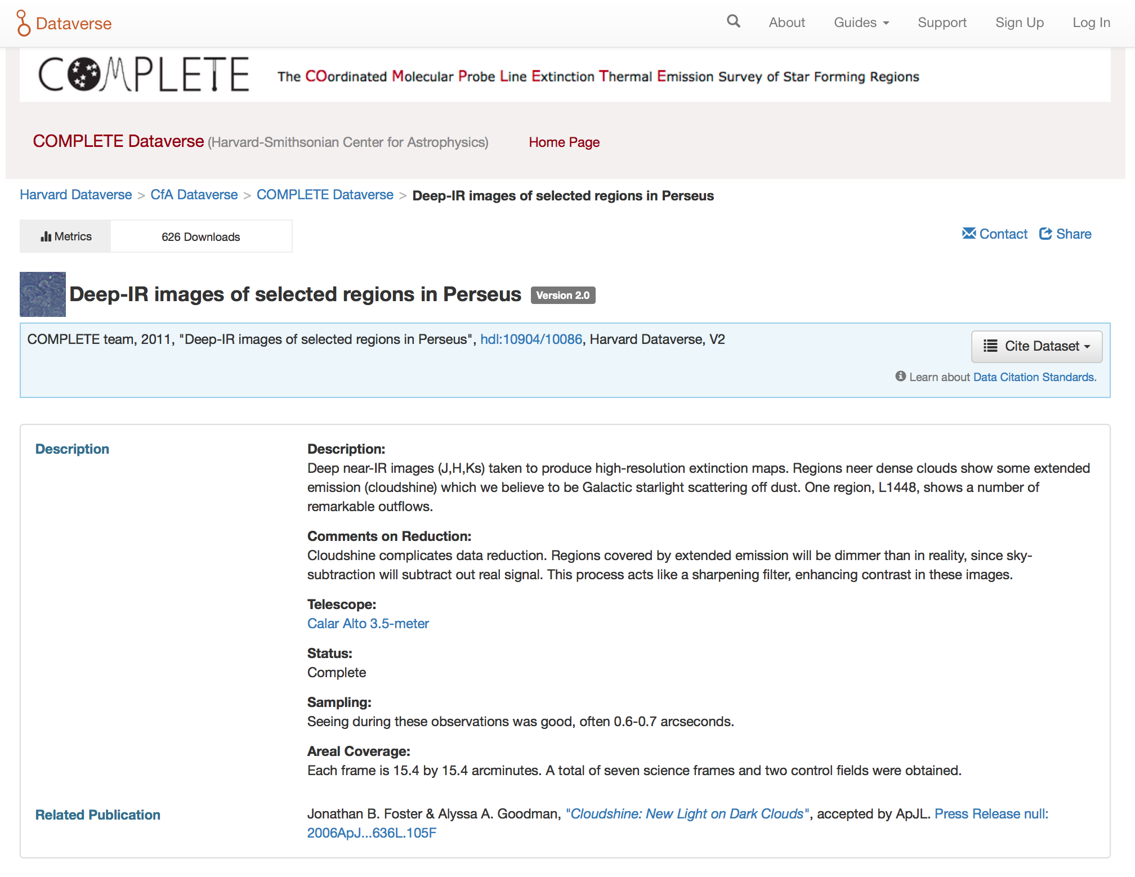
This single paper on “Cloudshine” (a small part of “COMPLETE”) has 626 downloads of its data set from Dataverse.
The paper itself has been cited 43 times.
Papers using data from the COMPLETE Survey have been
cited >7000 times since 2006, when data were first released online.
The 2006 “data paper” has been cited 150 times.
https://dataverse.harvard.edu/dataset.xhtml?persistentId=hdl:10904/10086

Slide 4
https://doi.org/10.1371/journal.pone.0104798

Slide 5
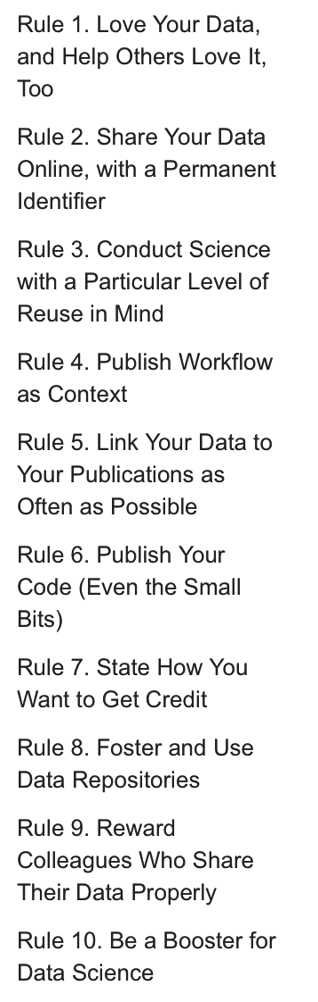
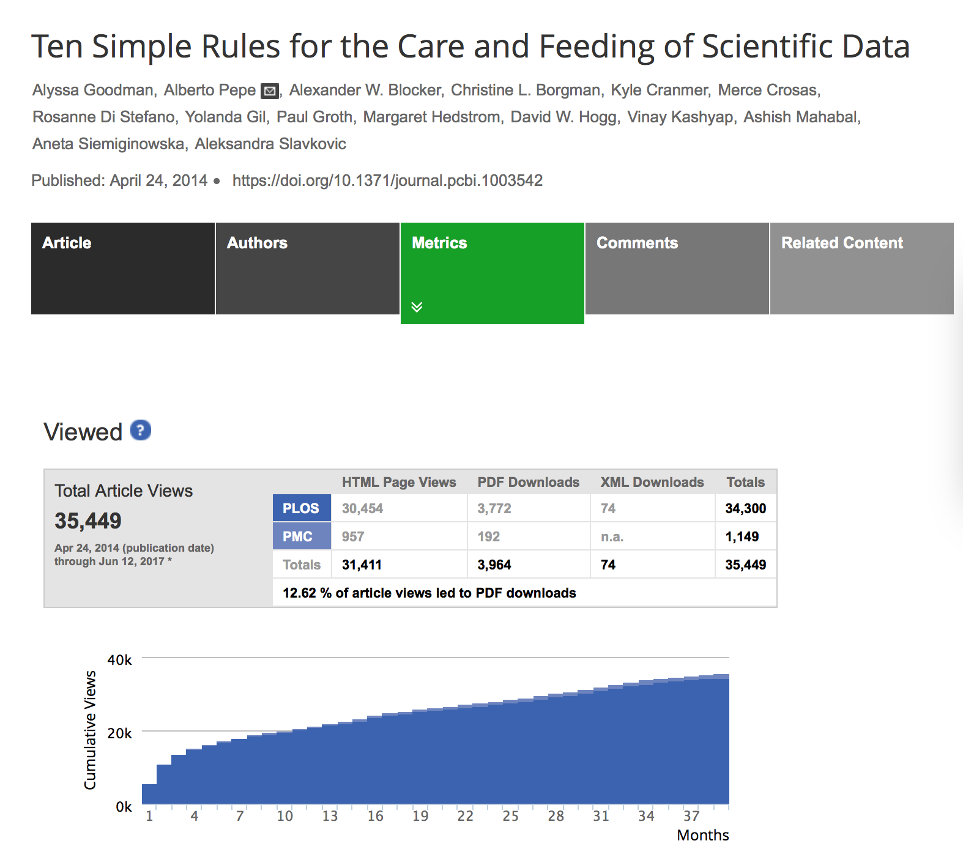
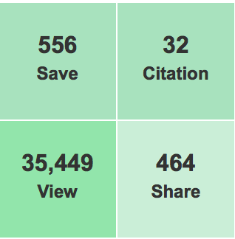
https://doi.org/10.1371/journal.pcbi.1003542

Slide 6
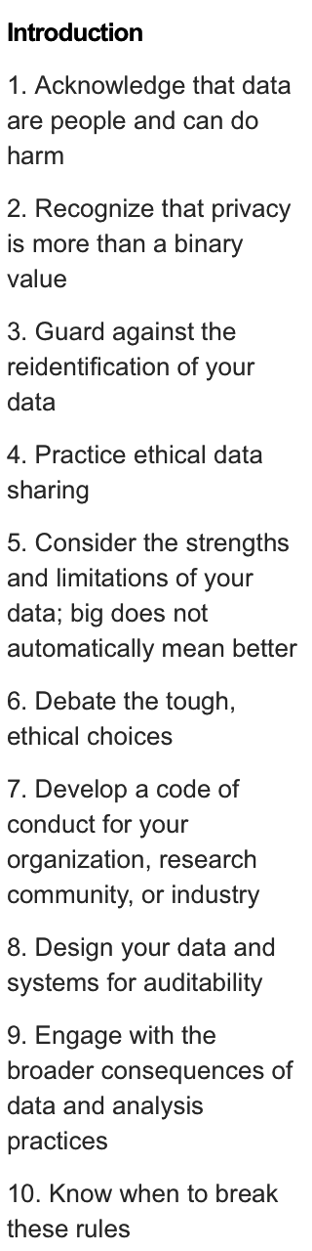
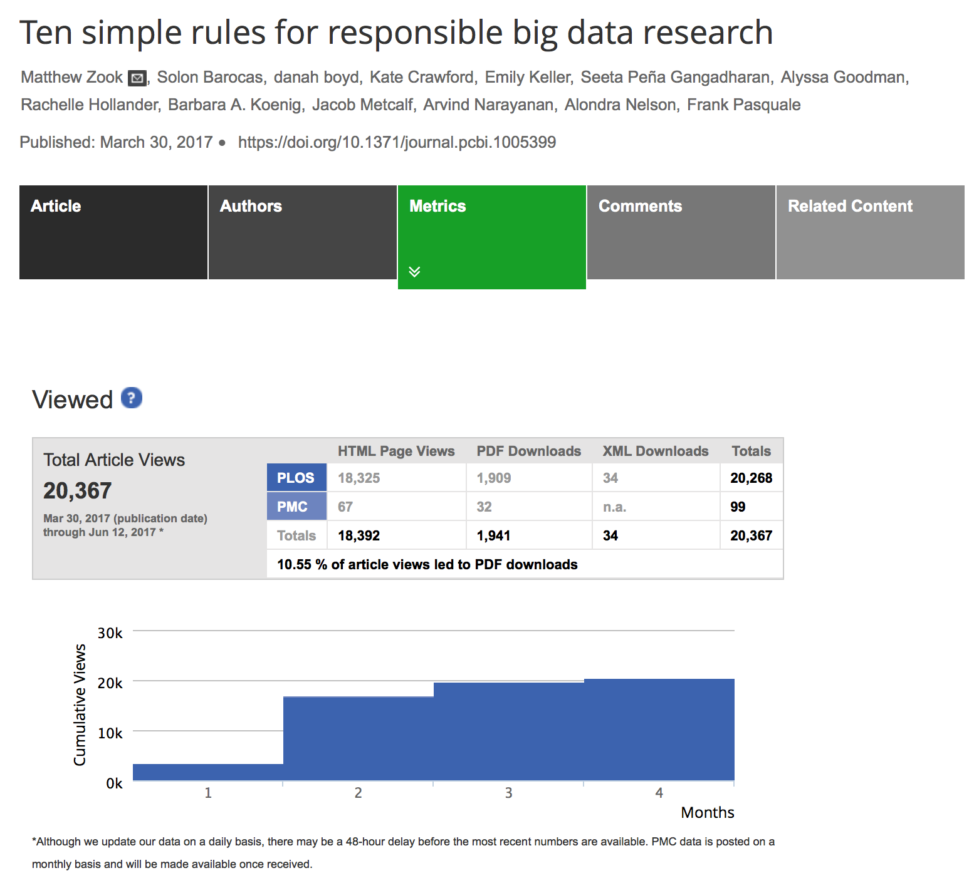
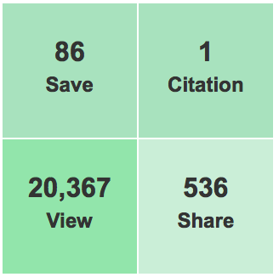
https://doi.org/10.1371/journal.pcbi.1005399

Slide 7
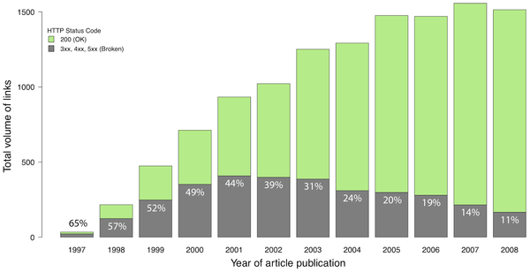

Figure 1. Volume of potential data links in astronomy publications.
Pepe A, Goodman A, Muench A, Crosas M, Erdmann C (2014) How Do Astronomers Share Data? Reliability and Persistence of Datasets Linked in AAS Publications and a Qualitative Study of Data Practices among US Astronomers. PLOS ONE 9(8): e104798. https://doi.org/10.1371/journal.pone.0104798
http://journals.plos.org/plosone/article?id=10.1371/journal.pone.0104798

