Slide 1
COVID-19 Awareness
Smithsonian Astrophysical Observatory
February 7, 2022

Slide 2
Agenda
Introduction
Building Access Procedures
Social Distancing
Face Coverings
Hygiene Protocols
Cleaning and Disinfection
Additional Guidance
Laboratories

Slide 3
Introduction
Overview of SAO Reopening

Slide 4
COVID-19 Training
Provides SAO staff and affiliates with information regarding mitigation strategies at SAO for the protection against COVID-19.
Is a mandatory requirement for return to work in the SAO facilities.
Those at 60/160 must also complete Harvard’s online COVID-19 Awareness training.

Slide 5
SAO’s Commitment to a Safe Working Environment
COVID-19 has created many challenges for research centers such as SAO. Throughout the pandemic, revised practices have been put into place at SAO for a safe workplace to protect the health and well-being of our staff and associated personnel – our most important and valuable assets.

Slide 6
Shared Partnership
Maintaining a safe environment during this pandemic has required a culture of shared responsibility between SAO staff and associates and building landlords.
Communication has been key to success throughout the pandemic.

Slide 7
To Assist Our Staff, SAO…
Monitors SAO facilities to make sure they are clean, disinfected and equipped with resources and protocols for safe conditions. Building managers work with staff to ensure landlords comply with commitments.
Provides training to staff regarding COVID-19 best practices so they have the knowledge and tools to return to the workplace in a safe manner.
Protects our staff by providing PPE and disinfecting supplies.

Slide 8
Phased Reopening
MA: Proceeded through four reopening phases with requirements for all industries.
May 29, 2021: COVID-19 restrictions lifted in MA, with the exception of face coverings in certain places. Mask guidance has changed several times since then.
Continue to encourage all industries to follow CDC guidance for cleaning and hygiene protocols.
SAO: Submitted reopening plans to SI for each phase and is presently in phase 3. The emphasis during phases 1 - 3 is on teleworking; participation in on-site work has been voluntary. Otherwise, remote work continues.

Slide 9
SAO Reopening Phases
Phase 1: Only mission critical lab staff came into the facilities.
Phase 2 (6/29/20): Approved office workers at CDP and 60 Garden Street could return on-site voluntarily.
Because the HVAC system at 160 Concord Ave needs to be upgraded, occupancy was and still is limited to ad-hoc office and low-level lab access. SAO is working with SI and the building landlord to upgrade the ventilation system.
Phase 3 (6/3/2021): Most protocols remained in place, including occupancy limits of 25 – 30%. Research associates and visiting graduate students were allowed back.
Phase 3 Updates: (July 2021): Occupancy limits increased to 50% for all SAO locations except for 160 Concord Ave. (Nov 2021): Attempts to accommodate 160 staff with offices on the 2cnd & 3rd floors at 60 made. (Jan 2022): Controls tightened due to Omicron surge.

Slide 10
Updates Due to Surging Infection Rates – Jan 2022
Access restricted to only those approved to be on-site; and strictly limited to normal business hours.
Telework should be maximized.
All non-essential in-person/onsite activities should be postponed or canceled.
Close contact work (within 6’ of another person) should be postponed when at all possible. If these activities must take place, the supervisor must ensure there is a Job Hazard Analysis (JHA). Contact Safety for this.
Supervisors must ensure that particular attention is paid to common spaces and anticipate how many staff are scheduled to use those spaces at the same time. Breaks and use of common areas should be staggered.
Access on evenings and weekends is subject to prior DO approval and require special circumstances.

Slide 11
Travel: SI
November 22, 2021: SI Travel Policy updated:
SI approval relaxed for most travel scenarios, although travel still requires approval by the Unit Director. (Send a short email to Mike McCarthy indicating the dates, destination & explanation for the trip.)
Travel no longer needs to be considered mission critical providing the traveler is fully vaccinated and vaccination status is on file with OHS.
SI approval is still needed if the traveler is unvaccinated or if traveling to a U.S. State Department Risk Level 4 country. (Most countries are currently listed as Level 4 – see next slide.) Travel approval to a Level 4 country is highly unlikely unless there are extremely unusual or time-sensitive activities that are deemed mission-critical.
Although the surge of Omicron cases has not changed SI’s travel policy, travel for activities that are not allowed onsite (including to attend a meeting) is highly discouraged.

Slide 12
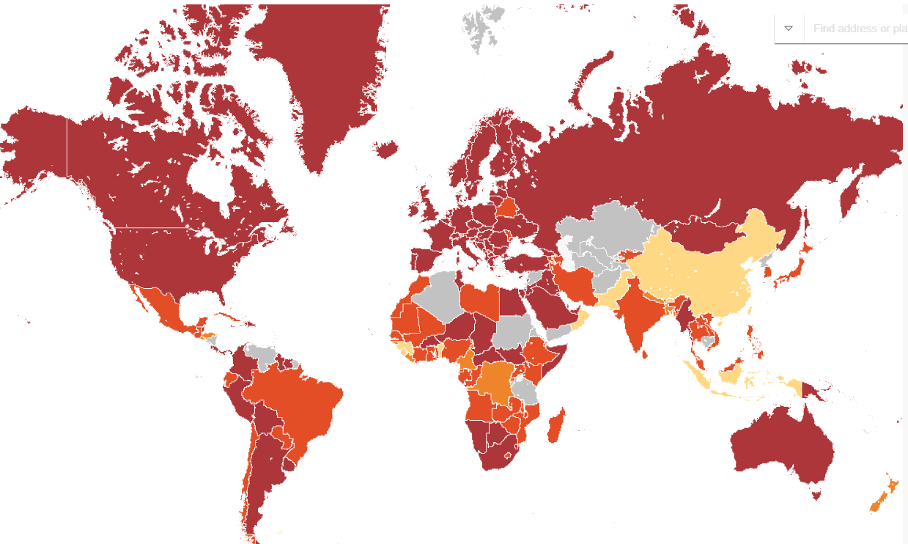
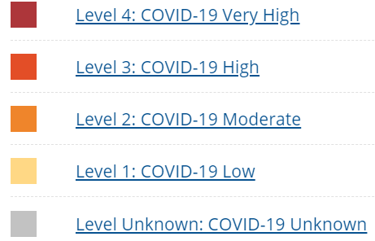
Updated January24, 2022

Slide 13
Travel Mandates
U.S. Dept. of State (12/6/21):
All air travelers, including U.S. citizens (regardless of vaccination status) must show a negative COVID-19 test taken within 24 hours of departure to the U.S.
Documentation of recovery from COVID-19 is accepted for those recently recovered.
CDC:
Does not recommend international travel until fully vaccinated (even fully vaccinated individuals may be at increased risk for getting and possibly spreading some COVID-19 variants).
CDC Order (11/8/21): requires non-immigrant, non-U.S. citizens traveling to the U.S. to be fully vaccinated & provide proof, with certain exceptions. https://travel.state.gov/content/travel/en/traveladvisories/ea/requirements-for-air-travelers-to-the-us.html

Slide 14
Vaccination
SI employees, volunteers, interns, fellows, and research associates are no longer required to be vaccinated. They are still requested to report their vaccination status to OHS-MedicalReview@si.edu.
Contractors must provide a certification of vaccination to their COTR as per SI’s Safety Protocols for On-site Contractors. If not vaccinated, the contractor must provide proof of a recent negative COVID test upon arrival at an SI facility.
Official visitors must present proof of vaccination or a recent negative COVID test upon arrival at a SI facility, as per SI’s Official Visitor Policy.
Guests at a special event must present proof of vaccination or a recent negative COVID test upon arrival at a SI facility, as per SI’s Special Events Policy.

Slide 15
Building Access
Approval and Building Access Procedures

Slide 16
Requirements for Approval
A request to enter any of the SAO facilities must first be approved. Approval is based on:
Completion of this training
Completion of Harvard’s online COVID-19 Awareness training, for those at 60/160.
Signing an Attestation Form that you have completed this training and have read SAO’s “Phase 2 Planning for additional staff returning to work on-site”.

Slide 17
Regular Access
If you require regular access (fixed schedule) to an SAO facility, discuss this with your supervisor. If your supervisor supports your request, the following email should be sent with a short rationale for on-site presence and a proposed schedule:
60 Garden St or 160 Concord Ave: Your supervisor should email Margaret Carroll and copy you on the email
CDP: Email your supervisor; CE staff: Your supervisor and Melinda Dillon
If approved, you will receive an e-mail confirmation with a set schedule and building specific entrance policies (to include COVID-19 testing for 60/160). If you are an SAO employee, you will also receive a confirmation e-mail from HR.
Please adhere to your confirmed schedule. Times are arranged to minimize personnel overlap to maintain social distancing.

Slide 18
Ad-hoc Access
Infrequent access (one-time or intermittent) to an SAO facility for a specific task is referred to as ad-hoc access.
To schedule ad-hoc access, e-mail the following people well in advance of your preferred date:
60 Garden or 160 Concord: Margaret Carroll
CDP: Your supervisor; CE staff: Your supervisor and Melinda Dillon
Indicate your requested date and time of day.
If approved, the applicable building contact will confirm via e-mail.

Slide 19
Harvard COVID-19 Testing Program
If you are approved for EITHER REGULAR OR AD-HOC ACCESS to 60/160, you will be required to participate in Harvard’s COVID-19 testing program, regardless of vaccination status.
This is one of the reasons that requesting access needs to be done well in advance of your preferred date – so there is sufficient time to set up your account in Color, the Crimson Clear associated app, Harvard’s testing portal. It may take several days to enroll in the C-19 testing program.
Weekly test kits (1 kit/week), which consist of a self-administered nasal swab, are picked up at B-207 (location of Cf help desk) at 60 Garden. Completed test kits are dropped off in the main lobby at 60 Garden (and many other locations around the Harvard campus). Test results are generally available within 12 – 24 hours.
To pick up test kits, staff may part at 160, subject to availability & free of charge (for now) by arranging this with Muriel Hodges.

Slide 20
Acknowledgement of No Symptoms
Any staff member who is feeling unwell is prohibited from entering a SAO building (allergy symptoms discussed later in training).
Entry into a SAO building is an explicit acknowledgement by the individual that they are symptom free.
This acknowledgement is made through the SI Health Screening Questionnaire.

Slide 21
SI Health Screening Questionnaire
SI has a self-managed, at home health screening exercise for staff to review each day they enter an SAO facility. Answers are not recorded.
This was updated January 2022 to reflect the many changing scenarios of increased positive cases.
SI OHS is following CDC guidelines for contact investigations, definitions of cases, and primary and secondary contacts.
The Questionnaire is included in an SI guidance document (to be sent to you) and discussed in the following slides.

Slide 22
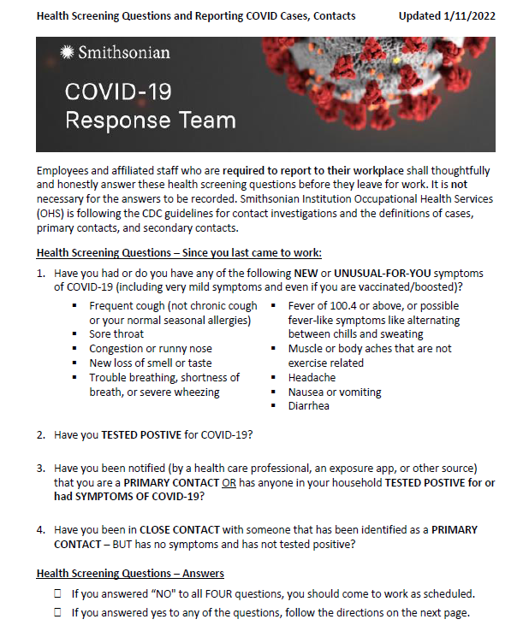

Slide 23
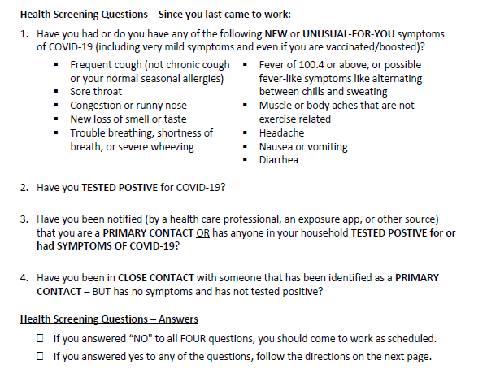

Slide 24
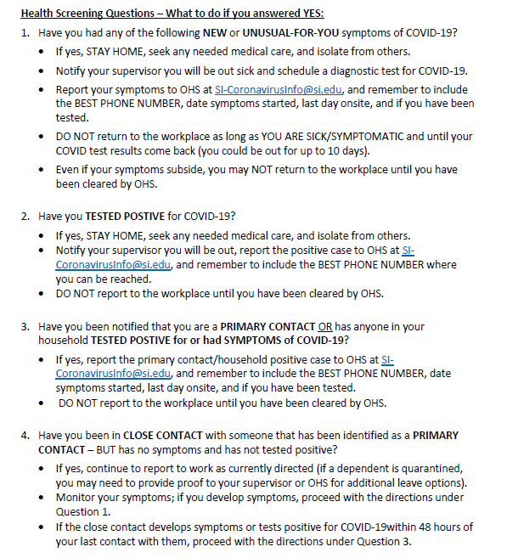

Slide 25

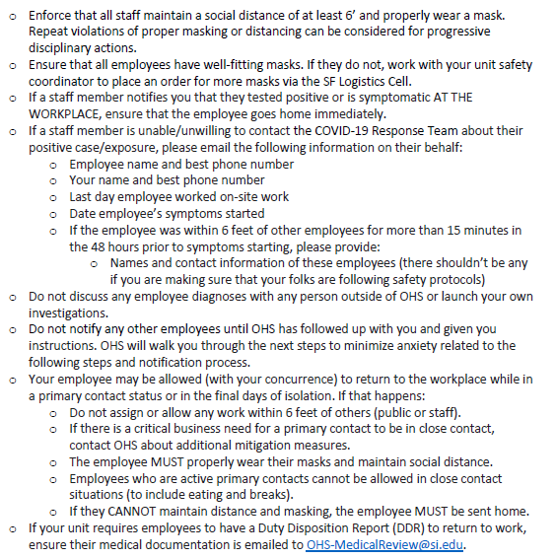

Slide 26
In Summary…
Should you be symptomatic and are awaiting test results, test positive, or are a primary contact, report your status to OHS by emailing SI-coronavirusinfo@si.edu with the following information:
Name and phone number
When you were last at work or are you a teleworker?
When were you exposed/did you test positive?
When did your symptoms begin (or are you asymptomatic)?
OHS will get back to you with further instructions. Because each person’s circumstance is different, OHS will decide when an employee may return to work depending on their diagnosis, vaccination status, or other variables. Do not return to the workplace until OHS has cleared you to do so.
For those at 60 Garden and 160 Concord Ave, HUHS will also contact you regarding contract tracing if you test positive.

Slide 27
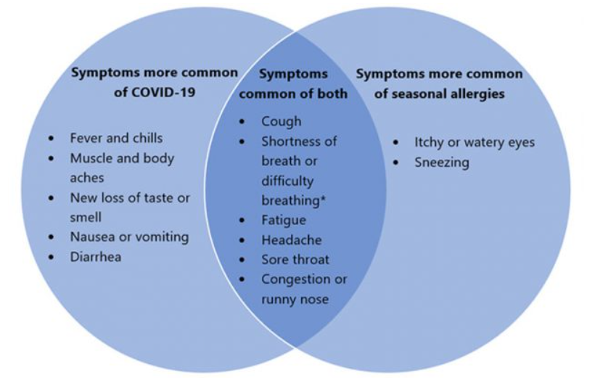
Allergy Symptoms or COVID-19?
CDC Infographic: Venn diagram of the overlap of COVID-19 symptoms with seasonal allergy symptoms:

Slide 28
Social Distancing
Operational Procedures and Facility Requirements

Slide 29

What can we do to promote social distancing in workplace common areas?

Slide 30
Staff Operations to Promote Social Distancing
Conduct virtual meetings whenever possible.
Facility access is pre-approved, prioritized and planned for social distancing.
Offices are limited to one person at a time. Time shifts for two-person offices are staggered if possible. If not, one person is moved to a single space, as available.
Avoid/minimize indoor group activities.
In person meetings are strongly discouraged. Remote meetings should continue.

Slide 31
Breakrooms
Minimize the use of breakrooms. Tables and chairs have been separated to allow for social distancing. Ensure a 6-foot separation distance between individuals.
Disinfect chairs, tables, refrigerator and appliance handles and vending machines before and after each use.
Use refrigerators only for the storage of sealed food items for individual consumption that day. Do not return items to the refrigerator after use.

Slide 32
Breakrooms at SAO Facilities
CDP: Touchless soap dispensers were installed.
60 Garden Street: The Pratt and Fish Bowl Areas have been set up as breakrooms. Offices, common areas, and outside tables are also available for eating.
160 Concord Ave: Conference rooms are used as breakrooms. Existing table arrangements allow for social distancing.

Slide 33
Restrooms
CDP and 160 Concord: Single use. Foot pedals have been installed on the doors exiting restrooms.
60 Garden: No longer single use. Wipes are available in restrooms.
Touchless faucets, soap and paper towel dispensers are in some restrooms.

Slide 34
Elevators
160 Concord: One person allowed at a time.
60 Garden: No longer one person at a time.
CDP: Two people are allowed by the landlord.
SI guidelines of one person at a time is encouraged. Or, if you have the option and are able, avoid the elevator and take the stairs. If not, wait until the elevator is less busy.
Touchless disinfectant dispensers are outside some elevators at CDP and in the lobby on all 3 floors at 160.

Slide 35
Stairways
CDP: Stairways are one way.
160: Stairways are now two way. The stairway door and other internal doors are blocked open so door handles do not have to be touched and for increased air circulation in these areas.
60: Stairways are two way.

Slide 36
Other/60 Garden Street
Entry into 60 Garden Street is restricted to three locations:
Main lobby
Bond Street
Red deck B building
Card readers at other locations remain active but will only allow entry for emergency personnel.
Kim wipes are available close to corridors or doors with handles throughout the facility.

Slide 37
Face Coverings
Community Protective Equipment (CPE)/Personal Protective Equipment (PPE)

Slide 38
Masks/Respirators - CDC
Masks (CPE):
Contain droplets and particles you breathe, cough, or sneeze out.
If they fit closely to the face, they can also provide you some protection from particles spread by others, including the virus that causes COVID-19.
Respirators (PPE):
Protect you by filtering the air and fitting closely on the face to filter out particles, including the virus that causes COVID-19.
Can also contain droplets and particles you breath, cough, or sneeze out so you do not spread them to others.

Slide 39
Masks
Masks include:
Disposable surgical mask made of multiple layers of non-woven material; or
A cloth mask made of multiple layers of finely woven, breathable fabric.
A mask with layers will stop more respiratory droplets getting inside your mask or escaping from your mask.
A mask should fit snugly to your face, covering your mouth and nose, without any gaps. A nose wire prevents air from leaking out of the top of the mask.

Slide 40
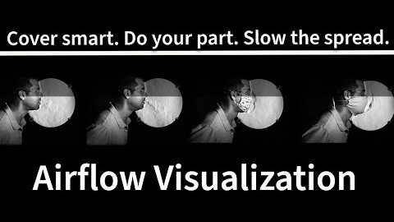
NIST Video
This National Institute of Standards and Technology (NIST) video illustrates airflow from breathing and coughing with and without a face covering:

Slide 41
Respirators for COVID-19
N95 respirators (95% efficient against particles of the most penetrating size) are approved by the National Institute of Occupational Safety & Health (NIOSH).
KN95’s are respirators made in China. However, since they are not approved by NIOSH, they are not considered respirators in the U.S. FDA has allowed respirators made in other countries to be used during the COVID-19 pandemic. It is important to note that there are many KN95s on the market that do not perform as advertised and/or are counterfeit.
N95’s & KN95’s are not reusable in the same way that cloth face coverings are. Although designed to be disposable, guidance during the pandemic is that these may be worn up to 40 hours of use or until they become wet, soiled, or damaged. Store it in a paper bag.

Slide 42
Mask Guidance/Requirements 2021
Throughout 2021, CDC and government masking guidance/requirements changed based on high transmission rates, vaccination status, and the health status of the individual.
SI policy remained the same: Employees & visitors must wear a face covering in SI buildings and leased spaces.
Surgical masks were provided to staff each day they entered the facility.
In January 2022, CDC updated their mask guidance. SI followed.

Slide 43
Updated CDC Mask Guidance/ SI Mask Policy 2022
CDC: Individuals should select the highest level of protection they can properly, comfortably, and reliably wear.
SI requires all staff and visitors to wear a multi-layer face covering, that fit snugly, which can include a multi-layer cloth face covering, surgical mask, KN95 mask, or an N95 respirator.
On-site SAO staff may wear a:
Multi-layer surgical mask or cloth face covering
KN95 mask
N95 respirator. SI “voluntary use” respirator training required.

Slide 44
How to Obtain Your Face Covering
Surgical masks:
Instructions for pick-up of your masks is included in your confirmation e-mail for building access.
Requests for additional masks should be sent, with sufficient time, to:
CDP: safety@cfa.harvard.edu
160 Concord: email Muriel Hodges
60 Garden: email Margaret Carroll
SAO-provided cloth face masks, KN95 masks, or N95 respirators: Contact safety@cfa.harvard.edu. Arrangements for respirator training for N95 use can be made through this address.

Slide 45
Use of Your Face Covering
Come to work with your own face mask (required by building landlords).
Replace your own face mask with the SAO provided mask/respirator in your closed office. Keep your personal mask in a clean location (e.g., in a sealed bag placed in your purse, pocket or office).
The mask/respirator must remain on throughout the workday. Exceptions:
When eating. Maintain 6 feet distance from all individuals.
When in your closed office.

Slide 46
Hygiene Protocols
Hand washing is one of the best ways to keep you and your family from getting sick.

Slide 47
Hand Washing
Hand washing should be done (for at least 20 seconds):
After:
Opening your office door as you arrive in the facility
Touching shared equipment or surfaces
Blowing the nose, coughing or sneezing
Using the restroom
When entering and exiting shared spaces
Before eating or preparing food and after putting on, touching or moving face coverings
Before and after breaks and shifts
If hand washing is not available, alcohol-based hand sanitizers with at least 60% ethanol or 70% isopropanol can be used.

Slide 48
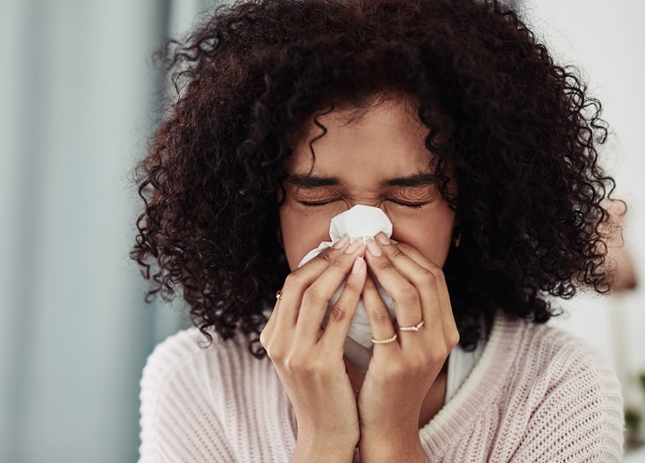
Coughing and Sneezing
Cover
Cover your mouth and nose with a tissue when you cough or sneeze.
Throw
Throw used tissues in the trash.
Cough or sneeze
If you don’t have a tissue, cough or sneeze into your elbow, not your hands.
Wash
Immediately wash your hands with soap and water or use an alcohol-based hand sanitizer if hand washing facilities are not available.

Slide 49
Cleaning & Disinfection
Disinfection & Disinfectants Used at SAO

Slide 50
Surface Contamination
Although not thought to be the main way the virus spreads, evidence has shown that:
SARS-CoV-2 may remain viable for hours to days on surfaces.
E.g., the virus can live for 2 – 3 days on plastic and stainless-steel surfaces.
Disinfecting shared surfaces and items before and after touching them; and washing hands or hand sanitizing afterwards prevents exposure from surface contamination.
It remains viable longer on hard surfaces than soft surfaces.

Slide 51
Disinfection
Many people think that when a surface is cleaned it is also disinfected, however, that is not the case.
Disinfection involves the use of a disinfectant that has been proven to inactivate the pathogen(s) of concern. The specific surface application time varies.

Slide 52
Disinfectants For COVID-19
EPA lists certain disinfectants that will inactivate the SARS-CoV-2 virus and a specified amount of time for the disinfectant to remain on the surface.
Disinfectants used by SAO landlords and purchased for use by SAO staff & associates are on EPA’s list. The specific contact time for these are on the following slides.

Slide 53
Disinfectants at SAO
The following disinfectants have been purchased for use in SAO offices and labs at CDP and 160 Concord:
Disinfecting wipes:
Clorox Commercial Wipes: 3-minutes
Clorox Healthcare Versa Sure Wipes: 5-minutes
Flex Disinfectant Wipes: 10-minutes
Disinfecting sprays:
ecoCleaner & Disinfectant: 10-minutes
Lysol Disinfectant Spray: 10-minutes
Professional Lysol Brand III: 10-minutes
ZEP Freshen Disinfectant: 10-minutes
Microban 24-hour Sanitizing Spray: 1-minute
There may be different “List N” disinfectants at 60 Garden.

Slide 54
Disinfection in SAO Facilities
Disinfection of facility surfaces, such as, common door handles, switches, railings, elevator touch surfaces, etc., is done daily by the cleaning contractor hired by the landlord.
Disinfection of equipment and doorknobs in individual offices, shared equipment and surfaces, conference room tables and chairs, handles of shared refrigerators and vending machines, and copy machines is the responsibility of SAO staff & associates as used.
At the completion of the day, tie up the trash and place the closed bag and empty barrel outside your office door for cleaning staff to pick up.

Slide 55
Disposable Gloves
Disposable gloves are available for disinfecting surfaces and handling shared equipment.
Consult your Department Administrator where these are kept for your department.
Immediately place disposable gloves in the trash after use using procedures in the next slide.
Do not wear gloves throughout the facility. This may provide a false sense of security.

Slide 56
Additional Guidance
Useful websites relating to COVID-19

Slide 57
Additional Guidance
CfA COVID-19 webpage:
https://www.cfa.harvard.edu/covid-19/information-and-response
SI COVID-19 website:
https://sinet.sharepoint.com/sites/COVID-19/
CDC COVID-19 website:
https://www.cdc.gov/coronavirus/2019-ncov/index.html
MA COVID-19 website:
https://www.mass.gov/info-details/covid-19-updates-and-information
Harvard Office/Lab Re-entry:
https://www.harvard.edu/coronavirus/planning-2020-21/steps-for-office-and-lab-reentry

Slide 58
CfA Covid-19 Website
What is on the CfA Covid-19 website? https://www.cfa.harvard.edu/covid-19/information-and-response
These training slides
Harvard & Smithsonian COVID policies
Building updates and access procedures
FAQs
Messages from the DO
Best practices
Useful links

Slide 59
Summary
The health, safety, and well-being of SAO staff and associated personnel is paramount.
COVID-19 is a highly infectious disease with a high mortality rate.
As a result, it has been and continues to be necessary to rely on mitigation and containment strategies to reduce infection and transmission.
The effort to remain safe during this pandemic requires a partnership between SAO, it’s staff and associates, and SAO facility landlords. We can only be successful if this partnership is strong and all involved are committed to this effort.

Slide 60
Questions
Any questions?
Questions can always be directed to:
safety@cfa.harvard.edu or https://www.cfa.Harvard.edu/internal/covid-19-questions-reopen
Lab workers: Please remain a few minutes longer to discuss procedures for laboratories.

Slide 61
Labs
COVID-19 procedures for work in SAO labs.

Slide 62
Approved Reopening Plans for Lab Entry
During SAO Phase 1, some lab workers conducted critical operations in SAO labs after meeting certain entry criteria.
Reopening Plans were submitted by each department with specific procedures for social distancing and other mitigation strategies.
Once approved, each of these plans were used to develop an overall work schedule for lab entry to allow for social distancing.
PPE and any additional training were provided.

Slide 63
Lab Safety Plan (LSP)/COVID Plan
CDP:
Each project-specific LSP was updated to include COVID-19 control and mitigation strategies.
All lab staff are required to read their LSP and Reopening Plan prior to working in the lab.
Operations where it is not possible to socially distance have been identified in each LSP with control methods for each.
60/160:
Each lab created a COVID plan for review and approval by Harvard Faculty of Arts & Sciences.

Slide 64
Shared Lab Equipment/Surfaces
Unless it is an emergency, do not use lab phones or other personnel’s phone, desk, tools or equipment.
Lab staff are responsible for disinfecting shared equipment and surfaces before and after use.
When disinfectants are low, email:
CDP: safety@cfa.harvard.edu
160 Concord: email Muriel Hodges.
Tie up the trash and place the closed bag and barrel outside the lab for pick-up by cleaning staff at the end of the day.

Slide 65
Personal Protective Equipment
PPE

Slide 66
PPE
A supply of COVID-related PPE has been purchased for labs and delivered to each project area.
Conduct regular inventories of PPE . When supplies are low, request additional PPE to safety@cfa.harvard.edu (with sufficient time to get these to you).

Slide 67
Gloves
Wear disposable nitrile gloves when handling hazardous materials and shared equipment, disinfecting surfaces, and emptying the trash.
Immediately place disposable gloves in the trash after use.
Remove gloves and other PPE (not mask) for breaks and restroom use.
Wear disposable gloves underneath re-usable gloves, such as cryogenic, heat-resistant or cut-resistant gloves. Wash your hands before and after each use.
Do not wear gloves throughout the facility. This may provide a false sense of security.

Slide 68
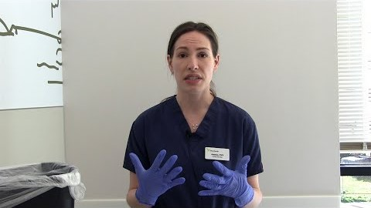
How to Remove Disposable Gloves

Slide 69
Eye Protection
Safety glasses are worn in labs when sharing and disinfecting surfaces and equipment, as well as, when working with chemicals.
Do not share safety glasses. Use your own.
Do not share laser eyewear. If limited supply, clean laser eyewear with a mild detergent soap and lukewarm water.
Disinfect reusable face shields before & after use.

Slide 70
Lab Coats
Lab coats serve as splash and contaminant protection.
These should be worn in the labs only.
Whenever possible, do not share.
Store your lab coat away from other lab personnel’s coat or place it in the bin for laundering (CDP).

Slide 71

Questions?

