Slide 1
Line Strengths and Self-Broadening of Pure Rotational Lines of Carbon
Monoxide and Nitrous Oxide Measured by Terahertz Time-Domain Spectroscopy
16 June, 2010
Weston Aenchbacher¹, Mira Naftaly², and Richard Dudley²
Presentation to the 11th HITRAN Database Conference, 2010, Cambridge, MA, USA
¹Currently with Drexel University, Department of Electrical and Computer Engineering, Philadelphia, PA, USA
²National Physical Laboratory, Hampton Road,Teddington, Middlesex TW11 0LW, UK

Slide 2
Introduction
NPL terahertz time-domain spectrometer (THz-TDS)
CO Measurements and Results
  Pure rotational lines from J’ = 3 ← 2 to J’ = 22 ← 21
  Pressures of 0.7 – 5.1 bar
N₂O Measurements and Results
  Pure rotational lines from J’ = 10 ← 9 to J’ = 53 ← 52
  Pressures of 0.7 – 1.2 bar

Slide 3
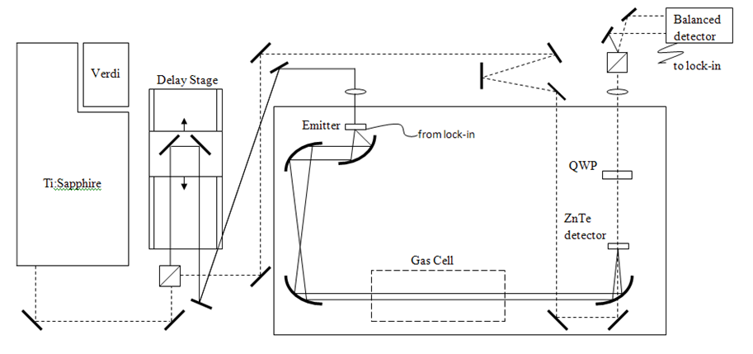
NPL Terahertz Time-Domain Spectrometer
probe beam
pump beam
Wollaston
prism
Ti-sapphire laser
mode-locked
800 nm centre wavelength
20 fs pulse length
77 MHz repetition rate
THz emitter
biased GaAs
ZnTe
electro-optic
crystal
biased photoconductive emitter
ZnTe refractive index proportional to THz E-field → rotates probe polarization

Slide 4
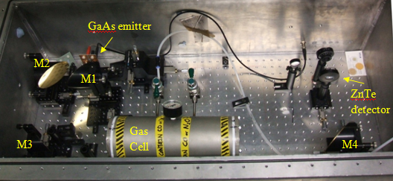
NPL Terahertz Time-Domain Spectrometer

Slide 5
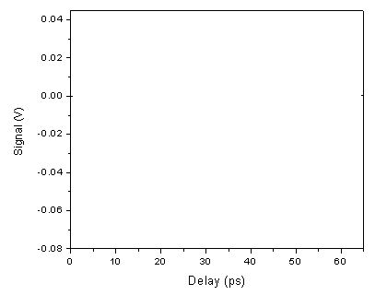
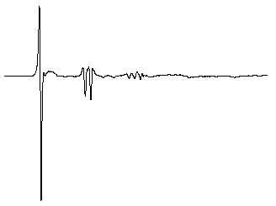
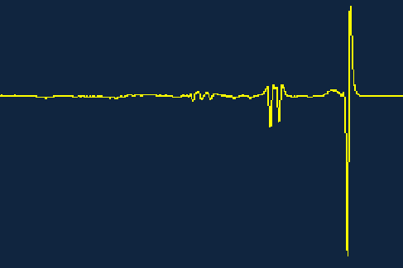
Time-Domain Measurement
THz pulse 20 ps
Probe pulse 2 fs →
~delta function
probe pulse

Slide 6
THz Spectrum
FFT
E-field in time
Spectrum
GHz

Slide 7
Sample CO Spectrum
(b)
(a)
(c)
Lorentzian line shape assumed
CO absorption spectrum at 2 bar
Section of sample fit at 2 bar
Expanded section of fit at 2 bar

Slide 8
Line Center with Pressure, J’ = 9 line
J’ = 9 center frequency (minus HITRAN) vs. pressure
error bars → standard deviation

Slide 9
Sample Measurements, J’ = 9 line
fit amplitude vs. pressure
fit linewidth vs. pressure
γself = slope
y error bars → standard deviation
x error bars → pressure uncertainty

Slide 10
CO Line Center Frequencies
peak frequency (minus HITRAN) for J’
Peak frequencies are taken as average over all pressure measurements.

Slide 11
CO Results
Line Intensity for J’
Self-Broadening coefficient for J’
Tabulated data can be found:
W. Aenchbacher, M. Naftaly, and R. Dudley, “Line strengths and self-broadening of pure rotational lines of carbon monoxide measured by terahertz time-domain spectroscopy,” Applied Optics 43/13, pp. 2490, 2010.
error bars → standard deviation
Notes:
Add at bottom, reference and “tabulated data can be found…”

Slide 12
Sample N₂O Absorption Spectrum
(left) absorption spectrum at 1.2 bar
(right) section of sample fit at 1.2 bar

Slide 13
N₂O Sample Measurements, J’ = 29 line
(top) absorption fit amplitude vs. pressure
(bottom) fit linewidth vs. pressure
vertical 95% confidence bars, horizontal pressure uncertainty
zero point included to decrease fit uncertainty

Slide 14
N₂O Line Center Frequencies
center frequency (minus HITRAN) for J”
error bars → 95% confidence interval

Slide 15
N₂O Parameters Calculated
Eqn. 1
Eqn. 2
Parameter |  | This work | From literature
B | From line frequencies & Eq. 1 | 12.53 ± 0.08 GHz 0.418 ± 0.03 cm⁻¹ | 0.419 cm^{-1 a,b}
 | From line intensities & Eq. 2 | 12.3 ± 0.2 GHz 0.410 ± 0.008 cm⁻¹
Electric dipole moment μ₀ |  | –0.155±0.003 D | -0.161 D ^{b,c}
E.D. Palik, K.N. Rao, “Pure rotational spectra of CO, NO, and N₂O between 100 and 600 microns”, J. Chem. Phys., 25/6 (1956) 1174-1176.
F. Rohart, J.-M. Colmont, G. Wlodarczak, J.-P. Bouanich, “N₂- and O₂-broadening coefficients and profiles for millimeter lines of ¹⁴N₂O”, J. Mol. Spectr., 222 (2003) 159-171.
L. Nguyen, J. Buldyreva, J.-M. Colmont, F. Rohart, G. Wlodarczak, E.A. Alekseev, “Detailed provile analysis of millimeter 502 and 602 GHz N₂O-N₂(O₂) lines at room temperature for collisional linewidth determination”, Mol. Phys., 104 (2006) 2701-2710.

Slide 16
N₂O Results
line intensity vs. J”
self-broadening coefficient vs. J”
Tabulated data available soon:
W. Aenchbacher, M. Naftaly, and R. Dudley, “Line strengths and self-broadening of pure rotational lines of nitrous oxide measured by terahertz time-domain spectroscopy,” JOSA B. (submitted May 2010).
error bars → 95% confidence interval

Slide 17
Conclusion
THz TDS demonstrated as a viable tool for measurement of molecular spectra.
Contribution to knowledge base of CO molecule
  Measured intensity and self-broadening with THz-TDS for the first time
Contribution to knowledge base of N2O molecule
  Measurements to fill gaps in available experimental data for intensity and self-broadening

Slide 18
Thank You
For more information:
W. Aenchbacher, M. Naftaly, and R. Dudley, “Line strengths and self-broadening of pure rotational lines of carbon monoxide measured by terahertz time-domain spectroscopy,” Applied Optics 43/13, pp. 2490, 2010.
W. Aenchbacher, M. Naftaly, and R. Dudley, “Line strengths and self-broadening of pure rotational lines of nitrous oxide measured by terahertz time-domain spectroscopy,” JOSA B. (submitted May 2010).
Weston Aenchbacher: wla24@drexel.edu
Mira Naftaly: mira.naftaly@npl.co.uk
Financial support for this work was provided by the National Measurement Office, an Executive Agency of the Department for Business, Innovation, and Skills. W. Aenchbacher was on the MSc, Photonics and Optoelectronic Devices Program of the University of St. Andrews

Slide 19
NPL Terahertz Time-Domain Spectrometer
beam
splitter
pump beam
THz emitter
biased GaAs
Ti-sapphire laser
mode-locked
800 nm centre wavelength
20 fs pulse length
77 MHz repetition rate
balanced
photodiode
detector
parabolic
mirror
parabolic
mirror
Wollaston
prism
probe
beam
delay
stage
THz
beam
ZnTe
electro-optic
crystal
Gas Cell
parabolic
mirror
parabolic
mirror
biased photoconductive emitter
ZnTe refractive index proportional to THz E-field (Pockels Effect) → rotates probe polarization

Slide 20
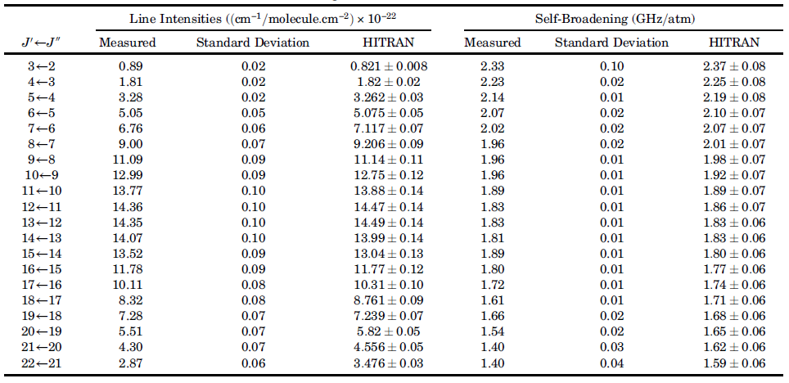
CO Tabulated Results
W. Aenchbacher, M. Naftaly, and R. Dudley, “Line strengths and self-broadening of pure rotational lines of carbon monoxide measured by terahertz time-domain spectroscopy,” Applied Optics 43/13, pp. 2490, 2010.
Notes:
Ditch tables

Slide 21
N₂O Tabulated Results - Intensities
J’←J’’ | Line intensities (cm⁻¹/molecule.cm⁻²) x 10⁻²² |  |  | J’←J’’ | Line intensities (cm⁻¹/molecule.cm⁻²) x 10⁻²²
 | Measured |  | HITRAN (error not reported) |  | Measured |  | HITRAN (error not reported)
 | value | error |  |  | value | error
10←9 | 0.54 | 0.08 | 0.570 | 32←31 | 2.84 | 0.18 | 2.85
11←10 | 0.64 | 0.08 | 0.727 | 33←32 | 2.67 | 0.11 | 2.73
12←11 | 0.93 | 0.15 | 0.901 | 34←33 | 2.62 | 0.13 | 2.61
13←12 | 0.90 | 0.08 | 1.09 | 35←34 | 2.62 | 0.16 | 2.47
14←13 | 1.28 | 0.10 | 1.29 | 36←35 | 2.34 | 0.11 | 2.33
15←14 | 1.52 | 0.08 | 1.49 | 37←36 | 2.19 | 0.11 | 2.18
16←15 | 1.54 | 0.11 | 1.70 | 38←37 | 2.15 | 0.11 | 2.03
17←16 | 1.79 | 0.10 | 1.91 | 39←38 | 1.91 | 0.11 | 1.87
18←17 | 2.06 | 0.12 | 2.11 | 40←39 | 1.74 | 0.11 | 1.72
19←18 | 2.13 | 0.13 | 2.30 | 41←40 | 1.63 | 0.08 | 1.57
20←19 | 2.3 | 0.08 | 2.48 | 42←41 | 1.57 | 0.09 | 1.43
21←20 | 2.65 | 0.17 | 2.64 | 43←42 | 1.36 | 0.08 | 1.29
22←21 | 2.63 | 0.12 | 2.78 | 44←43 | 1.25 | 0.08 | 1.16
23←22 | 2.78 | 0.15 | 2.90 | 45←44 | 1.32 | 0.07 | 1.03
24←23 | 2.94 | 0.15 | 2.99 | 46←45 | 1.01 | 0.08 | 0.916
25←24 | 2.96 | 0.20 | 3.06 | 47←46 | 0.92 | 0.08 | 0.809
26←25 | 3.04 | 0.14 | 3.10 | 48←47 | 0.93 | 0.08 | 0.710
27←26 | 3.13 | 0.12 | 3.12 | 49←48 | 0.74 | 0.08 | 0.620
28←27 | 3.15 | 0.21 | 3.11 | 50←49 | 0.58 | 0.08 | 0.539
29←28 | 3.03 | 0.13 | 3.07 | 51←50 | 0.58 | 0.08 | 0.466
30←29 | 2.98 | 0.13 | 3.02 | 52←51 | 0.64 | 0.08 | 0.400
31←30 | 3.04 | 0.17 | 2.94 | 53←52 | 0.39 | 0.08 | 0.342

Slide 22
N₂O Tabulated Results – Self-Broadening
J’←J’’ | Self-broadening (GHz/atm) |  |  | J’←J’’ | Self-broadening (GHz/atm)
 | Measured |  | HITRAN 2%≤ error ≤5% |  | Measured |  | HITRAN 2%≤ error ≤5%
 | value | error |  |  | value | error
10←9 | 3.1 | 0.3 | 3.24 | 32←31 | 2.7 | 0.1 | 2.61
11←10 | 2.7 | 0.6 | 3.21 | 33←32 | 2.5 | 0.1 | 2.61
12←11 | 3 | 0.4 | 3.18 | 34←33 | 2.6 | 0.1 | 2.58
13←12 | 2.5 | 0.5 | 3.12 | 35←34 | 2.7 | 0.1 | 2.58
14←13 | 3.1 | 0.2 | 3.09 | 36←35 | 2.5 | 0.1 | 2.55
15←14 | 2.8 | 0.2 | 3.06 | 37←36 | 2.6 | 0.1 | 2.55
16←15 | 2.8 | 0.2 | 3.03 | 38←37 | 2.6 | 0.1 | 2.52
17←16 | 2.8 | 0.2 | 2.30 | 39←38 | 2.8 | 0.1 | 2.52
18←17 | 3 | 0.2 | 2.97 | 40←39 | 2.5 | 0.1 | 2.49
19←18 | 2.8 | 0.2 | 2.94 | 41←40 | 2.6 | 0.1 | 2.49
20←19 | 2.6 | 0.1 | 2.91 | 42←41 | 2.6 | 0.1 | 2.49
21←20 | 2.9 | 0.2 | 2.88 | 43←42 | 2.6 | 0.1 | 2.46
22←21 | 2.6 | 0.1 | 2.85 | 44←43 | 2.6 | 0.3 | 2.46
23←22 | 2.8 | 0.1 | 2.82 | 45←44 | 3.1 | 0.3 | 2.43
24←23 | 2.8 | 0.2 | 2.79 | 46←45 | 2.6 | 0.4 | 2.43
25←24 | 2.8 | 0.1 | 2.78 | 47←46 | 2.8 | 0.5 | 2.43
26←25 | 2.7 | 0.1 | 2.76 | 48←47 | 3.4 | 0.3 | 2.40
27←26 | 2.7 | 0.1 | 2.73 | 49←48 | 2.5 | 0.2 | 2.40
28←27 | 2.8 | 0.1 | 2.70 | 50←49 | 2.7 | 0.4 | 2.40
29←28 | 2.6 | 0.1 | 2.67 | 51←50 | 2.7 | 0.5 | 2.37
30←29 | 2.7 | 0.1 | 2.67 | 52←51 | 3.4 | 1.1 | 2.37
31←30 | 2.8 | 0.1 | 2.64 | 53←52 | 2.3 | 0.4 | 2.37

Slide 23
Carbon Monoxide

Slide 24
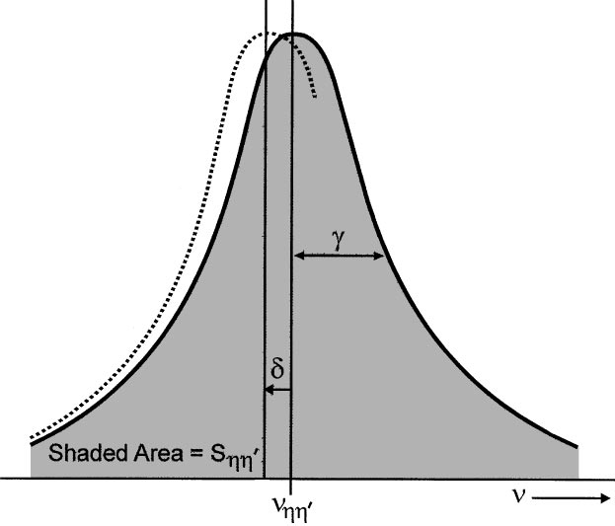
Line Parameters
L.S. Rothman, et al: The HITRAN molecular spectroscopic database and HAWKS (HITRAN atmospheric workstation): 1996 Edition, J. Quant. Spectrosc. Radiat. Transfer Vol. 60/5, 1999, pp 665-710.
where

Slide 25
Measuring Line Parameters
Assume each line is a Lorentzian:
and assuming an ideal gas:
obtain A(P) by Lorentzian fits at various pressures

